Slide 1

PRIORITY SETTING AND RESOURCE ALLOCATION PROCESS (PSRA) AND SERVICE STANDARDS
2023 TRAINING SERIES
APRIL 12, 2023

Slide 2
Meaningful Involvement of People Living with Affected by HIV
A principle that aims to realize the rights and responsibilities of people living with HIV, including their right to self-determination and participation in decision-making processes that affect their lives
Serve on the Commission and /or be active participants at meetings and decision-making process
Provide ongoing feedback on service experiences (positive and negative)- with aim of improving services
Work towards equity and social justice

Slide 3
PRIORITY SETTING AND RESOURCE ALLOCATION PROCESS (PSRA)
Part 1

Slide 4
Learning Objective
Learn about the responsibility of planning councils to use sound information and a rational decision-making process when deciding which services and other program categories are priorities (priority setting) and how much to fund them (resource allocation).

Slide 5
Common Terms and Acronyms
Planning Council (PC)/Planning Body (PC) = Commission on HIV
Recipient = Division of HIV and STD Programs (DHSP)
DHSP – Division of HIV and STD Programs; local administrator of HIV/STD prevention and care funds and programs in Los Angeles County
PSRA – priority setting and resource allocation
HRSA – Health Resources and Services Administration (federal agency that manages Ryan White dollars)
CDC – Centers for Disease Control and Prevention (federal agency that managers and awards prevention funds to DHSP
RW - CARE Act- Ryan White (the law that carves out $ for PLWH is named after him)

Slide 6
More Acronyms
PY- Program Year (begins March 1 of one year and ends February 28 of next year; this is the program year defined by HRSA)
FY- Fiscal Year (begins July 1 of one year and ends June 30 of the next year; used by LA County)
NCC- Net County Cost (Los Angeles County funds; non-grants)
MAI- Minority AIDS Initiative
COH – Commission on HIV
PLWHA- people living with HIV/AIDS

Slide 7

What is Priority Setting and Resource Allocation (PSRA)?
The most important decision-making responsibility for Commissioners
Decision on priority setting and resource allocation must be based on data and not anecdotal information or impassioned pleas.

Slide 8
Service Ranking & Priority Setting
The process of deciding which HIV/AIDS services are the most important in providing a comprehensive system of care for all PLWH in an Eligible Metropolitan Area (in our case, LA County).
Must address needs of all PLWH regardless of:
Who they are
Where they live in the County
Stage of disease
Whether they currently receive services
Priorities should be set without regard to the availability of funds (RWHAP Part A or other funds)

Slide 9
What are the Ryan White Service Categories?
These are the services ranked by the Commission during the PSRA process.
Fall under two categories:
Core Medical Services
Support Services
HRSA requires that 75% of funds be allocated to core medical services, but waiver requests are permitted.

Slide 10
Core Medical Services
AIDS Drug Assistance Program (ADAP) Treatments
Local AIDS Pharmaceutical Assistance Program (LPAP)
Early Intervention Services (EIS)
Health Insurance Premium and Cost Sharing Assistance for Low-Income Individuals
Home and Community-Based Health Services
Home Health Care
Hospice Services
Medical Case Management, including Treatment Adherence Services
Medical Nutrition Therapy
Mental Health Services
Oral Health Care
Outpatient/Ambulatory Health Services
Substance Abuse Outpatient Care

Slide 11
Support Services
Child Care Services
Emergency Financial Assistance
Food Bank/Home Delivered Meals
Health Education/Risk Reduction
Housing
Legal Services
Linguistic Services
Medical Transportation
Non-Medical Case Management Services
Other Professional Services
Outreach Services
Permanency Planning
Psychosocial Support
Referral for Healthcare and Support Services
Rehabilitation
Respite Care
Substance Abuse (residential)

Slide 12
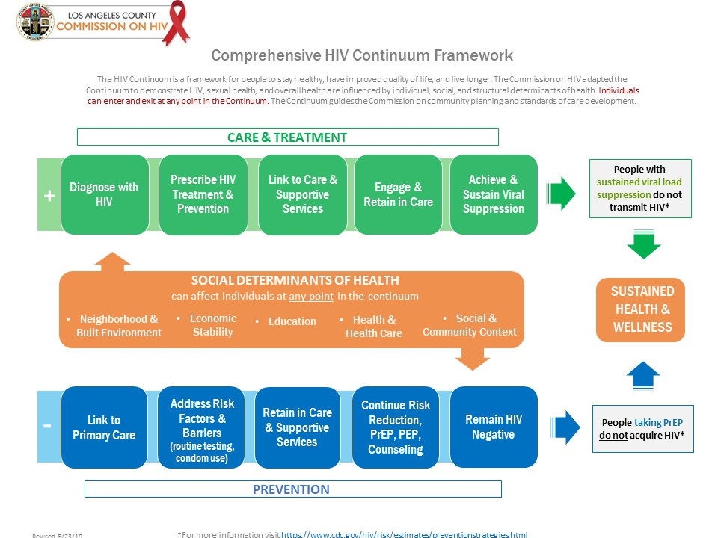
Notes:
A map or guide for integrated planning for Commission; developed by SBP

Slide 13
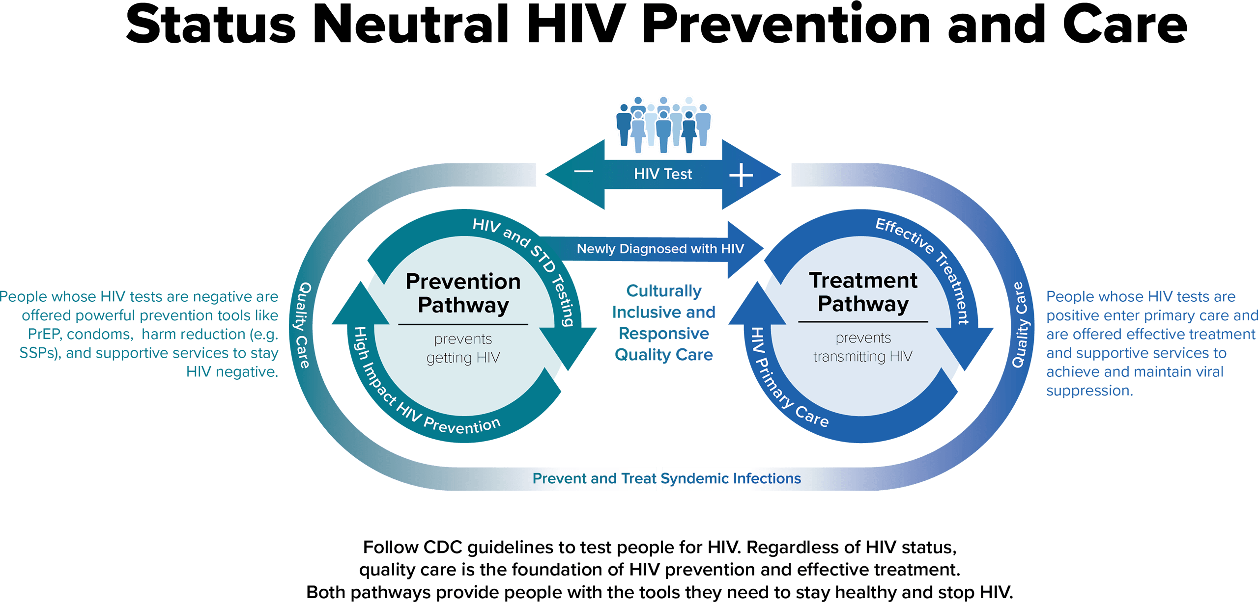
Source: https://www.cdc.gov/hiv/policies/data/status-neutral-issue-brief.html

Slide 14
Service Category Ranking
Reminder!
Prioritization: rank service categories based on consumer needs (ONLY!)
What services are needed from most to least?
Funding availability is not a consideration for prioritization; only consumer needs.

Slide 15
Resource Allocation
Process of determining how much RWHAP Part A & Minority AIDS Incentive (MAI) program funding will be allocated to each service category
Commission instructs DHSP on how to distribute the funds in contracting for service categories
Some lower-ranked service categories may receive larger allocations than higher-ranked service categories due to cost per client and services available through other funding streams

Slide 16
Directives
Provides guidance to the recipient (DHSP) on how to meet prevention and care priorities
Involves instructions for the recipient to follow in developing requirements for providers for use in procurement and contracting
Usually addresses populations to be served, geographic areas to be prioritized, and/or service models or strategies to be used

Slide 17
Reallocation
Process of moving program funds across service categories after the initial allocations are made.
This may occur:
Right after grant award (partial and final award), since the award is usually higher or lower than the amount requested in the application
During the program year, when funds are underspent in one category and demand is greater in another

Slide 18

Steps in the PSRA Process

Slide 19
Needs Assessment
Joint effort of Commission and DHSP
Includes:
Epidemiologic profile
Estimates of the number and characteristics of PLWHA with unmet needs and of individuals with HIV/AIDS who are unaware of their status
Assessment of service needs and barriers to care
Resource inventory/review
Provider capacity and capability
Assessment of unmet needs/ service gaps

Slide 20
PSRA Tips
There is no one “right” way to set priorities and allocate resources.
An evolving process influenced by status-neutral approaches and ever-changing healthcare landscape like Medi-Cal expansion
Process must be documented in writing and used to guide deliberations and decision-making.
A grievance can be filed if the planning council deviates from its established process.
Agree on the PSRA process, its desired outcomes, and responsibilities for carrying out the process.

Slide 21
Steps in the Priority Setting and Resource Allocations Process
1
Review core medical and support service categories, including HRSA service definitions
2
Review data/information from DHSP
3
Agree on how decisions will be made; what values will be used to drive decisions.

Slide 22
Steps in the Priority Setting and Resource Allocations Process
4
Rank services by priority
5
Allocate funding sources to service categories by percentage
Ranking DOES NOT equal level of allocation by percentage

Slide 23
Steps in the Priority Setting and Resource Allocations Process
6
Provide instructions to DHSP on how best to meet the priorities (Directives)
7
Reallocation of funds across service categories, as needed
Directives are informed by COH Committees, Caucuses, Task Forces, data, PLWH and provider input.

Slide 24

Data to Support Decision-Making
Needs assessment findings
Cost-effectiveness data
Actual service cost and utilization data
Priorities of PLWH who will use services
The amount of funds provided by other sources
Use of RWHAP Part A, B and MAI funds to work with other services providers

Slide 25
Leveraging Other Resources
Program Income from RWHAP Parts B, C, D, F
Housing Continuum of Care/HOPWA
SAMHSA
Medicaid/Medicare
Net County Cost (NCC)
County-wide resources
Centers for Disease Control and Prevention
Other grants
Understand service categories and amounts of funding provided by sources other than RWHAP Part A

Slide 26
Expenditure Review
Prior Program Year (PY) final expenditures for Ryan White Part A, B, and Minority AIDS Initiative (MAI) funds
Current PY estimates for Part A, MAI and Part B expenditures
Future RFP funding needs
Current and future PY expanded service categories with anticipated expenditures increases.
Total PY budget amounts for Parts A, B and MAI
Net County Cost (NCC) budget for services

Slide 27

Planning Tools Unique to the Commission
Paradigms and Operating Values

Slide 28
Paradigms for Decision-Making
Compassion: response to suffering of others that motivates a desire to help
Equity: allocating levels of investments and commitment that meaningfully address the needs of populations disproportionately impacted by HIV/STDs and social determinants of health

Slide 29
Operating Values
Efficiency: accomplishing the desired operational outcomes with the least use of resources
Quality: the highest level of competence in the decision-making process
Advocacy: addressing the asymmetrical power relationships of stakeholders in the process
Representation: ensuring that all relevant stakeholders and constituencies are adequately represented in the decision-making process

Slide 30
COMPREHENSIVE HIV PLAN (CHP)
Serves as a jurisdictional HIV/AIDS Strategy
Living document and roadmap to guide HIV prevention and care planning throughout the year
Addresses local needs and opportunities for improvement
Emphasizes collaboration and coordination
https://hiv.lacounty.gov/our-work
Notes:
The County submitted its Integrated HIV Prevention and Care Plan for 2022-2026 in December 2022. This plan was developed in partnership with DHSP and a vast array
of community and organizational partners.
The plan is developed in response to the Integrated HIV Prevention and Care Plan Guidance, including the Statewide Coordinated Statement of Need, CY 2022-2026 disseminated by the Health Resources and Services Administration (HRSA) and the Centers for Disease Control and Prevention (CDC), and as such presents a blueprint for HIV service coordination along the entire spectrum of HIV prevention and care
Staff will drop the link to the CHP in the Chat

Slide 31
SERVICE STANDARDS
Part 2

Slide 32
Learning Objective
Learn about the joint responsibility shared by planning councils and the recipient to develop service standards for service categories ranked during the PSRA process.

Slide 33

What are service standards?
Outline the elements and expectations a RW service provider follows when implementing a specific service category
Ensure that all RW service providers offer the same basic service components
Establish the minimum level of service of care for consumers throughout the jurisdiction
Notes:
Providers can exceed minimal service expectations but must meet basic expectations.

Slide 34

What are service standards? Cont.
Universal Service Standards
Category-Specific Service Standards
General Agency Policies and Procedures
Client Rights & Responsibilities
Staff Requirements and Qualifications
Cultural and Linguistic Competence
Intake and Eligibility
Referrals and Case Closures
Patient’s Bill of Rights
Includes link to Universal Service Standards
Core Medical Services
Support Services

Slide 35

HRSA HAB Guidance on Service Standards
Service standards:
Must be consistent with Health and Human Services (HHS) guidelines on HIV care and treatment and the HRSA/HAB standards and performance measures, including the National Monitoring Standards
Should not include HRSA/HAB performance measures or health outcomes
Should be developed at the local level
Are required for every funded service category
Should include input from providers, consumers, and experts
Be publicly accessible and consumer friendly

Slide 36

How are service standards used?
Service standard development is a joint responsibility shared by DHSP and COH
Service standards are used in:
DHSP Request for Proposals (RFPs)
Service provider contracts
Monitoring/quality assurance
Service providers are encouraged to participate in COH deliberations and planning activities

Slide 37
How are service standards used? Cont.
DHSP provides summary information to the COH on the extent to which the service standards are being met (based on monitoring)
DHSP assists with identifying possible need for revisions to service standards including:
Service providers are following standards, but medical outcomes are not good
Service providers are finding it very difficult to meet some standards
Service standards are discouraging flexibility needed for service innovations or appropriate care for diverse populations

Slide 38

Developing Service Standards
No required format or specific process defined by HRSA/HAB
The Standards and Best Practices (SBP) Committee:
Leads the service standards development process for the Commission on HIV
Agrees on outline to be used for all service standards
Determines the schedule for review/update (at least every 3 years)
Notes:
Service standards guide providers in implementing funded services.
The service standards set the minimum requirements of a service and serve as a base on which the recipient’s clinical quality management (CQM) program is built.

Slide 39

Developing Service Standards Cont.
The SBP Committee prioritizes reviews/updates to service standards based on:
Service category’s allocation level
Local priority
DHSP’s RFP schedule
A consumer, provider, or service concern
To respond to environmental or continuum of care changes (COVID-19, status neutral approach)
Notes:
Service standards guide providers in implementing funded services.
The service standards set the minimum requirements of a service and serve as a base on which the recipient’s clinical quality management (CQM) program is built.

Slide 40
Service Standards Review Cycle
SBP Review
SBP develops review schedule based on service rankings, DHSP RFP schedule, or in response to environmental or continuum of care changes
COH Review
Commission on HIV reviews the revised/updated service standards and holds vote to approve. Once approved, the service standards are sent to DHSP
Dissemination
Service standards are posted on the COH website for public viewing and to encourage use by Non-Ryan White providers
SBP conducts review/revision of service standards which includes input from consumers, experts, and service providers
DHSP uses service standards in RFP’s, contracts, and for monitoring/quality assurance. DHSP provides feedback to COH on provider implementation
SBP posts the revised/updated service standards for a public comment period
Revisions to service standards occur at least every 3 years or as needed

Slide 41

Value of Flexible Service Standards
Service standards are not meant to be prescriptive or too specific because it may limit how service providers implement services
Flexible service standards:
Allow service providers to adjust service delivery to meet the needs of individual clients
Reduce the need for frequent revisions to service standards

Slide 42
Trends/Approaches to Consider
Make standards as short and concise as possible
Use charts to increase clarity
Put common information into Universal standards only
Use plain language
Develop standards that tell consumers what the service is and what they can expect if they receive it
Limit best practice content– have service standards specify requirements
Consider providing best practice separately
If used, clearly label such content as optional
Include a link to the Universal service standards in category-specific service standards

Slide 43
Encouraging Non-RW Providers to Adopt/Follow Service Standards
Incentives
Good preparation if provider applies for RW funding in the future
Help in providing service appropriate for PLWH– especially if PLWH are not the provider’s only clients
Serve on an expert panel that helps develop or update service standards
Disincentives
Takes effort to learn about service standards if not providing RW services
Requires staff training
May cost more

Slide 44


Slide 45







https://hivconnect.org/
510 S. Vermont Ave, 14th Floor, Los Angeles, CA 90020
hivcomm@lachiv.org
213.738.2816
HIVCommissionLA
@HIVCommissionLA

