Slide 1
ATTACHMENT 2
EDUCATION RIGHTS
FOR YOUNG PEOPLE AND BY YOUNG PEOPLE
Sherrie Bradford, Cristopher Espino, Alexandria Maldonado, Myriah Smiley
Alliance for Children’s Rights Education Advocates
Alaina Moonves-Leb & Barbara Lundqvist
LA County Office of Child Protection
Notes:
Each person gives name and current title (for example, Alaina Moonves-Leb, Project Director at the Office of Child Protection and facilitator of the Education Advocates Project)

Slide 2
Alliance for Children’s Rights Education Rights Advocates
  A legal services non-profit that provides services directly to systems-involved youth and families as well as works on policy/systemic issues to improve the child welfare system.
  The Alliance has facilitated the Education Rights Advocates for the last 3 years.
  The cohort includes young people with lived expertise who provide youth trainings, advocacy, and consultation on education rights for youth involved in systems.
Notes:
Alex
Alex will introduce the entire group as lived experts at the end of all intros.
We are a group of lived experience people who all had our own personal struggles in education by not knowing our educational rights. We together, aim at making sure no one experiences the struggles that we did.
[Then Alex shares key points from the slide]

Slide 3
  Education Rights Videos for Young People, by Young People
      The why, the how, best practices, and lessons learned
  Videos Presentation
  Discussion
WELCOME
AGENDA
Notes:
Barbara or Alaina

Slide 4
WHY
EDUCATION RIGHTS
FOR
YOUNG PEOPLE
BY
YOUNG PEOPLE
  Youth need to be able to advocate for themselves
  Youth need resources that they can understand and can refer back to
HOW
  Lived Experts from Education Rights Advocates & Castillo Consulting Partners
  Met in the evenings online and in person
  Youth are the decision makers about how long the videos are, topics, how can we engage youth in the videos, scripts, who is interested in telling their stories, graphics, etc.
  Kids in the Spotlight
Notes:
Sherrie
My name is Sherrie Bradford, and I am the Prevention and Early Intervention Training Coordinator at CASA of Los Angeles. In my role, I lead training initiatives that focus on three main components: life skills, financial literacy, and career and education exploration. With my background as an advocate, trainer, and educator, I have been able to use these skills to advocate for youth, specifically in this project. A unique element we’ve introduced is a creative lens, designed to engage young people more effectively with the content.
Why is this important?
It is essential for youth to be able to advocate for themselves. By providing them with the knowledge and tools to take control of their futures, we help empower them to make informed decisions.
How do we make it happen?
Youth need resources that are accessible, easy to understand, and ones they can refer back to as they move forward. To ensure these resources are effective, we collaborate with lived experts from Education Rights Advocates and Castillo Consulting Partners.
Our sessions are held both online and in person, typically in the evenings to accommodate youth schedules. What makes this approach different is that youth themselves play an active role in shaping the project. They are the decision-makers when it comes to key aspects, such as video length, topics, engagement methods, scriptwriting, who shares their stories, and the design of graphics and other creative elements.
Additionally, our partnership with Kids in the Spotlight adds another layer of creativity and outreach, helping amplify the voices of young people and deepening their engagement in the process.

Slide 5
BEST PRACTICES
LESSONS LEARNED
EDUCATION RIGHTS
FOR
YOUNG PEOPLE
BY
YOUNG PEOPLE
  Compensate youth for their lived expertise
  Opportunities for youth to work together
  Leverage electronic tools for asynchronous work
  Continually follow-up, but still let youth lead
  Allow youth to be creative in how they participate
  If possible, utilize a professional videographer/editor
  Multiple work sessions with youth
  Start with educating the youth themselves about rights, give them time to understand how rights are applied to their own lived experiences
  Support youth in how to make impactful testimonial statements, not objectifying themselves
    What they want to share
    How they want to share
    Make sure their stories are serving their goals
  Build a collaborative approach respecting different perspectives and experiences
Notes:
Cris
Barbara/Alaina can jump in on lessons learned if needed

Slide 6
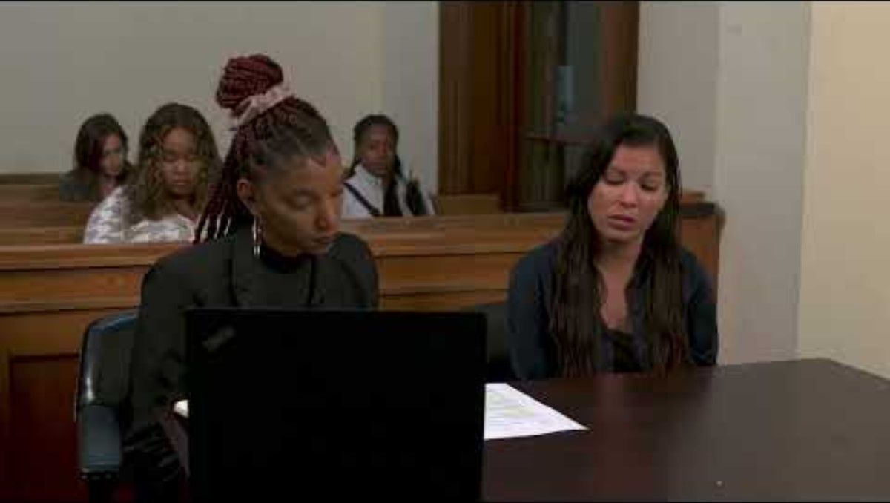
EDUCATION RIGHTS HOLDERS SKIT
Notes:
Myriah
We are now excited to present to you 2 of the videos that we made.
This first one is about education rights holders. As you all know, an education rights holder is a very important person for each youth in the foster care system, and yet none of us in the group were every really taught what they were when we were going through the system, or told that we had a right to have someone working with us to help make the best education decisions for us. We made this video to help young people understand what an education rights holder is, and how that should be addressed in court for them.

Slide 7
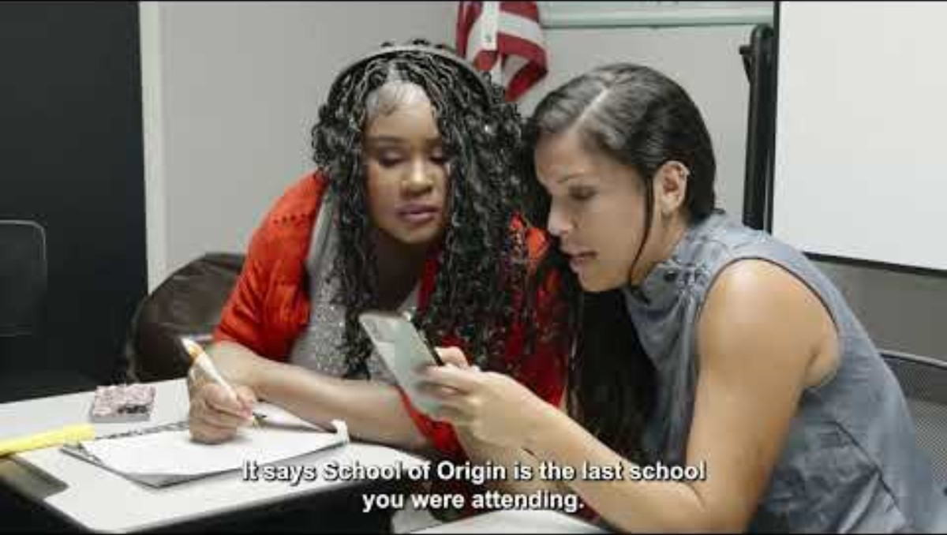
SCHOOL STABILITY CLASSROOM SKIT
Notes:
Myriah
This next video is about School of Origin rights. When we started learning about our education rights as part of cohort, almost everyone of us wished we had known about school of origin rights. I know for me, it would have made a huge difference—and we have another video where I share a testimonial about how changing school impacted me. But in this video, you will see two young people discussing this right. We hope it will help young people in the system better understand this right.

Slide 8
DISSEMINATION PLAN
VIDEO TOPICS
  Immediate Enrollment
  Graduation
  School of Origin
  Education Rights Holders
COMMUNITY BASED ORGANIZATIONS
YOUR ORGANIZATION
COUNTY
AGENCIES
All videos/flyers and a dissemination toolkit will be made available on the Office of Child Protection website: Office of Child Protection
You can also email Barbara Lundqvist at blundqvist@ocp.lacounty.gov
or Alaina Moonves-Leb at amoonves-leb@ocp.lacounty.gov for access to the videos/resources
Notes:
Alaina/Barbara

Slide 9
DISCUSSION &
CALL TO ACTION
Q.
Q.
Q.
How do you currently engage youth around education rights?
How can/will you use these videos in your work?
How can we integrate these videos into existing trainings/processes to ensure that youth have conversations about their education rights often?
Notes:
Barbara

Slide 10
THANK YOU!
Alaina Moonves Leb
amoonves-leb@ocp.lacounty.gov
Barbara Lundqvist
blundqvist@ocp.lacounty.gov
Alexandria Maldonado
amaldonadopsych@gmail.com
Cristopher Espino
crise2003@g.ucla.edu
Myriah Smiley
Sherry Bradford
Sbradford@casala.org

