Slide 1


New Obligations for Schools on Immigration Enforcement and Document Sharing
Fredy Ruiz
Immigrant Relations Coordinator
11/5/2025

Slide 2

Deferred Action for Childhood Arrivals
Since its inception in 2012, the Deferred Action for Childhood Arrivals (DACA) program has provided significant support to eligible undocumented youth who came to the United States as children.
By granting temporary protection from deportation and work authorization, DACA has enabled recipients to access various opportunities that were previously unattainable.

Slide 3

AB 495 - The Family Preparedness Plan Act
Governor Newsom has signed AB 495, the Family Preparedness Plan Act of 2025, into law. This legislation introduces a series of important protections and procedures aimed at shielding children and families, especially those at risk due to immigration enforcement.
Licensed childcare facilities and preschools are now prohibited from collecting or retaining information regarding the immigration or citizenship status of children or their families, except where specifically required by law.

Slide 4

AB 49: Protecting Student Records and Family Privacy
AB 49 limits how schools respond to federal immigration enforcement inquiries.​
Limited Access to Campuses: Prohibits LEAs from allowing immigration enforcement officers from entering nonpublic areas of a school site without providing a valid judicial warrant, judicial subpoena, or court order.​
Restrictions on Records Disclosure: Student records, including immigration-related documents, may not be released, in any other manner, to immigration authorities unless a valid court order is presented or with parental or guardian’s written consent.

Slide 5

SB 98: Limiting Immigration Enforcement on School and Campus Grounds
SB 98 expands California’s “sensitive location” protections, further shielding schools and universities from immigration enforcement activities.​
Prohibition on Enforcement Actions: Immigration enforcement agents may not enter school grounds, libraries, or campus facilities without judicial authorization.​
An “immigration officer” means any state, local, or federal law enforcement officer who is seeking to enforce immigration law.

Slide 6

Action Steps for School Districts
To comply with AB 49 and SB 98, educational institutions should consider the following steps:
Review and update policies
Train Administrators, Staff, and Faculty
Designate a Compliance Officer
Communicate Changes with Families
School Safety Plans need to be updated and include information on Immigration Enforcement

Slide 7

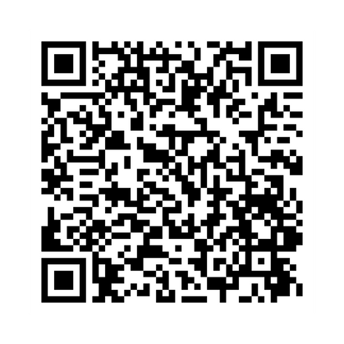
Thank you!
Fredy Ruiz​
Immigrant Relations Coordinator​
Ruiz_Fredy@lacoe.edu

