Slide 1

TRAINING
Commission on HIV (COH) Overview
Updated 12.17.21

Slide 2
Learning Objectives
Learn about the purpose of the COH, its ordinance and bylaws, and structure.
Learn about integrated HIV prevention and care community planning.

Slide 3
Why Community Planning?
Public process increases transparency and accountability
Diverse perspectives (populations, disciplines, and services)
Informed by personal and professional experiences
Opportunity for equitable access to information and to influence how services are prioritized and shaped

Slide 4
COH Ordinance: integrated hiv/std prevention & care planning council (PC)
Formally became an integrated PC in 2013
PC is federally required in order to receive Ryan White funds for HIV/AIDS services
Housed as an independent commission within the Executive Office of the Board of Supervisors (BOS) of the County of Los Angeles.
Advise Division of HIV and STD Programs (DHSP) on how to prevent and reduce HIV infections via the integrated HIV plan (aka Comprehensive HIV Plan or CHP)
51 voting members; 1/3 must be unaffiliated consumers (UC)
UC: PLWH and currently using a Ryan White (RW) Part A – funded service(s) and not employed by an agency receiving RW Part A funds.

Slide 5
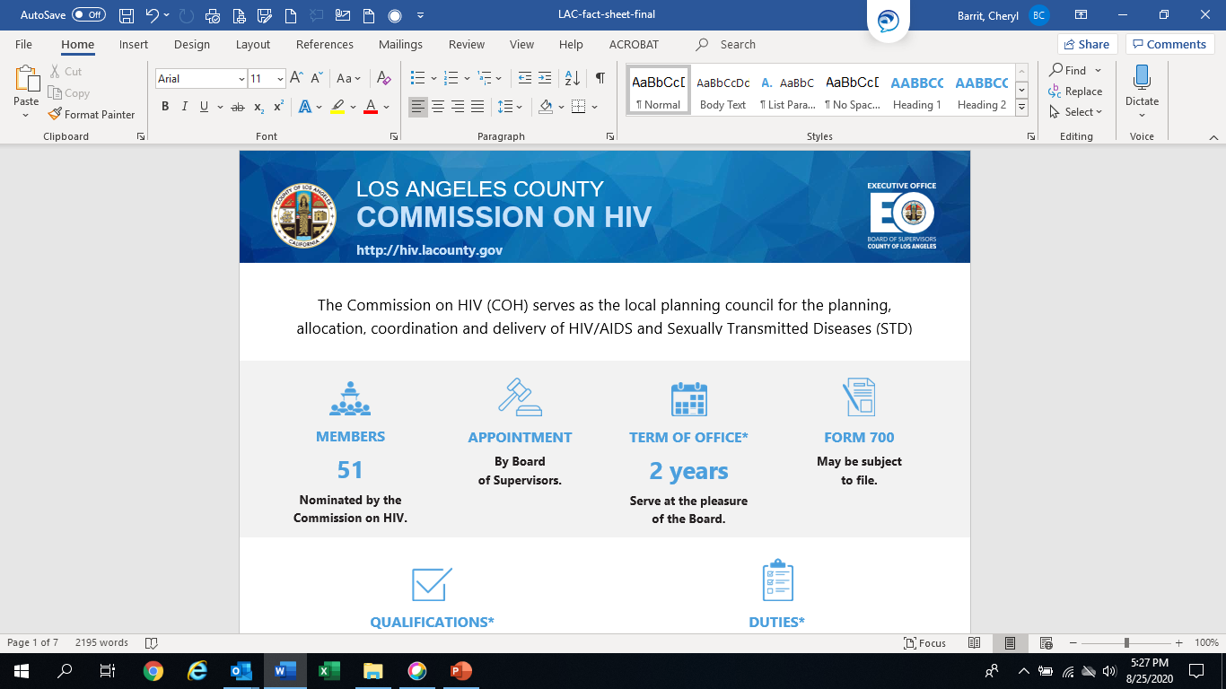

Slide 6
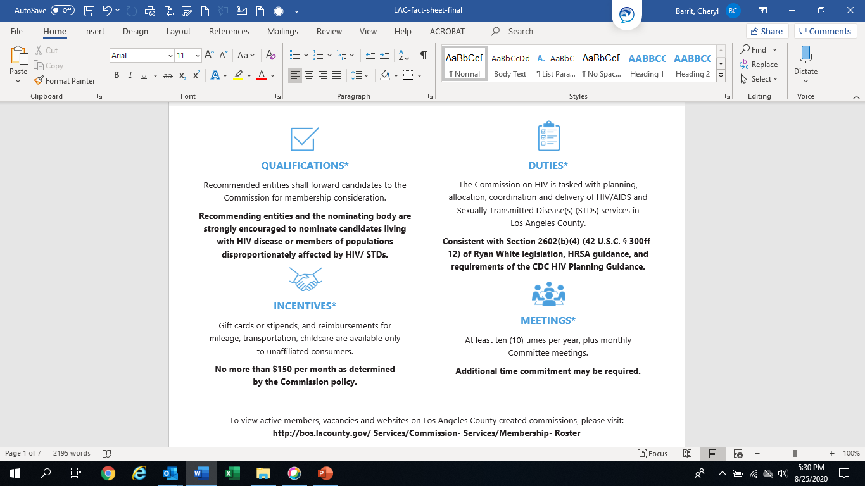

Slide 7
Board of Supervisors
COH
Executive Committee
Operations
Standards and Best Practices
Planning, Priorities and Allocations
Public Policy
Workgroups, Caucuses, Task Forces
Women’s Caucus, Consumer Caucus, Transgender Caucus, Black Caucus, Aging Task Force, Prevention Planning Workgroup

Slide 8
Duties of the Commission

Slide 9
Duties
A. Develop a comprehensive HIV plan that is based on assessment of service needs and gaps and includes a defined continuum of HIV services; monitor the implementation of that plan; assess its effectiveness; and collaborate with DHSP to update the plan on a regular basis;

Slide 10
Duties
B. Develop standards of care for the organization and delivery of HIV care, treatment and prevention services;

Slide 11
Duties
C. Establish priorities and allocations of Ryan White Part A and B and CDC prevention funding in percentage and/or dollar amounts to various services; review the grantee’s allocation and expenditure of these funds by service category or type of activity for consistency with the Commission’s established priorities, allocations and comprehensive HIV plan; provide and monitor directives to the grantee on how best to meet the need and other factors that further instruct service delivery planning and implementation; and provide assurances to the Board of Supervisors and HRSA verifying that service category allocations and expenditures are consistent with the Commission’s established priorities, allocations and comprehensive HIV plan;
Notes:
Talk about letter of concurrence or non concurrence; COH does not determine which agency gets funding.

Slide 12
Duties
D. Evaluate service effectiveness and assess the efficiency of the administrative mechanism with particular attention to outcome evaluation, cost effectiveness, rapid disbursement of funds, compliance with Commission priorities and allocations, and other factors relevant to the effective and efficient operation of the local EMA’s delivery of HIV services;

Slide 13
Duties
E. Plan and develop HIV and public health service responses to address the frequency of HIV infection concurrent with STDs and other co- morbidities; deploy those best practices and innovative models in the County’s STD clinics and related health centers; and strategize mechanisms for adapting those models to non-HIV-specific platforms for an expanded STD and co-morbidity response;

Slide 14
Duties
F. Study, advise and recommend to the Board of Supervisors, the grantee and other departments’ policies and other actions/decisions on matters related to HIV;

Slide 15
Duties
G. Inform, educate, and disseminate information to consumers, specified target populations, providers, the general public, and HIV and health service policy makers to build knowledge and capacity for HIV prevention, care, and treatment; and actively engage individuals and entities concerned about HIV;

Slide 16
Duties
H. Provide a report to the Board of Supervisors annually, no later than June 30th, describing Los Angeles County’s progress in ending HIV as a threat to the health and welfare of Los Angeles County residents, with indicators determined by the Commission in collaboration with DHSP; make other reports as necessary to the Board of Supervisors, the grantee and other departments on HIV-related matters referred for review by the Board of Supervisors, grantee or other departments;

Slide 17
Duties
I. Act as the planning body for all HIV programs in DPH or funded by the County;

Slide 18
Duties
J. Make recommendations to the Board of Supervisors, the grantee and other departments concerning the allocation and expenditure of funding other than Ryan White Part A and B and CDC prevention funds expended by the grantee and the County for the provision of HIV-related services.

Slide 19
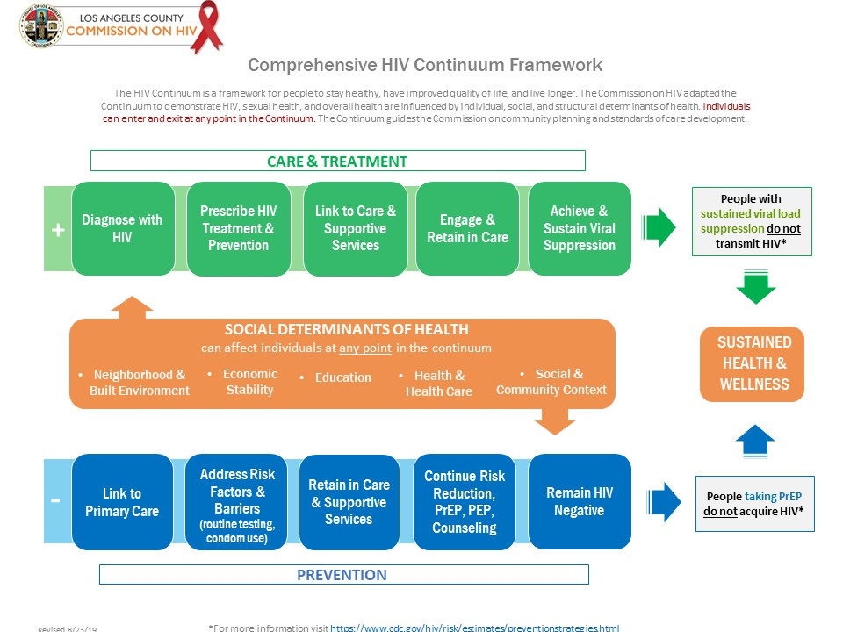
Notes:
A map or guide for integrated planning for Commission; developed by SBP

Slide 20
DHSP and COH Roles and Responsibilities
DHSP and COH = two independent entities, both with legislative authority and roles
Some roles belong to one entity and some are shared
Effectiveness requires clear understanding of the roles and responsibilities of each entity, plus:
Communications, information sharing, and collaboration between the recipient, COH, and COH support staff
Ongoing consumer and community involvement

Slide 21
COH, DHSP, Roles & Responsibilities
Task | Committee | DHSP | COH
Carry Out Needs Assessment | PP&A | X | X
Do Comprehensive Planning | PP&A | X | X
Set Priorities* | PP&A |  | X
Allocate Resources* | PP&A |  | X
Manage Procurement |  | X
Monitor Contracts |  | X
Evaluate Effectiveness of Planning Activities | PP&A | X | X
Evaluate Effectiveness of Care Strategies | SBP | X | X
Do Quality Management |  | X | [Care Standards & Committee Involvement]
Assess the Efficiency of the Administrative Mechanism* | Operations |  | X
Member Recruitment, Retention and Training | Operations |  | X
* Sole responsibility of RWHAP Part A Planning Councils

Slide 22


Slide 23





https://hivconnect.org/
510 S. Vermont Ave, 14th Floor,
Los Angeles, CA 90020
hivcomm@lachiv.org
213.738.2816
Facebook: @HIVCommissionLA
Twitter: @HIVCommissionLA
Instagram: @HIVCommLA

