Slide 1
Empowerment, Dating & Disclosure
Dr. Erica Holmes​

Slide 2


Agenda
Women’s Empowerment
Trauma; Threat to Empowerment
Dating and Disclosure
Partner Services and Resources

Slide 3
EMPOWERMENT
Empowerment is the process of increasing the authority and responsibility of individuals and groups to make choices and to transform those choices into desired actions and outcomes

Slide 4
Five Major Components of Women’s Empowerment
Women’s sense of self-worth;
Their right to have and determine choices;
Their right to have access to opportunities and resources;
Their right to have the power to control their own lives, both within and outside the home; and
Their ability to influence the direction of social change to create a more just social and economic order, nationally and internationally.

Slide 5


Slide 6
Self Empowerment
Set Reasonable Goals
1
Engage in Self Care
2
Practice Positive Self Talk
3
Surround Yourself With Positive People
4
Be Assertive
5
Practice Gratitude
6
Notes:
Set Reasonable Goals
Measurable, achievable goals are an important component of self-empowerment, and understanding how to set them can help you feel good about your achievements. If you want to run a marathon, start with smaller, increasing distances rather than trying to run 26.2 miles on day one.
Practice Self-Care
Self-care includes any activity that you do for yourself to feel happy and healthy. It can include everything from eating right and exercising to treating yourself to a spa treatment. Scheduling time to relax and rejuvenate will make you more productive. Additionally, being kind to yourself can help you be confident in your ability to address and overcome hardship.
Develop a Positive Attitude
People who believe they control their own destiny — rather than giving in to external concepts such as fate, luck, or circumstance — are more likely to take charge of their future. Cultivate a positive attitude and outlook by evaluating your strengths and weaknesses, pursuing your passions, and trusting in your ability.
Surround Yourself with Positive People
Laughter is contagious — and so are pessimism and negativity. Surrounding yourself with like-minded, motivated people can help you feel empowered to achieve your goals. If your self-esteem takes a blow, schedule time with positive friends, peers, and family members. Experiencing their positivity can improve your mental well-being, minimize your negativity, and empower you to follow your dreams.
Use Positive Self-Talk
To live a self-empowered life, focus on what you can do as opposed to what you can’t. For example, if you want to apply for a promotion that requires fluency in Spanish, instead of saying “I don’t speak Spanish,” try “I don’t speak Spanish yet. I can learn.” Practicing self-affirmations and displaying confidence in your ability to achieve your goals can help you take steps to achieve them.
Be Assertive
People who strive toward personal empowerment must be comfortable expressing their thoughts, ideas, and needs. If you’re invited to a party but have an important presentation the following day, let the host know you’ll be leaving early to prepare. Or if you and a co-worker are collaborating on a project, but you’re doing most of the work, don’t feel guilty about addressing the situation head-on and asking them to do their share.
Practice Gratitude
Being thankful for what we have and the innate gifts that we have been given is a surefire way to increase feelings of empowerment. Establish a daily gratitude practice by choosing three things you are thankful for each day

Slide 7

To Being Empowered
Notes:
Threats to .empowerment
Anything that serves to disempower.
Those things that take away
Authority
Choice
Power
Control
Ability to implement

Slide 8
What is Trauma?
The experience of a real or perceived threat to life or bodily integrity
OR
the life or bodily integrity of a loved one
AND
Overwhelms the persons usual way of coping
Notes:
The Greek word “trauma” means an injury or wound.
Trauma is not an event but a response to an experience in which the individual’s response has been compromised (both mind and body).
Both Subjective and Objective components Objective –There was an event that was life threatening or could cause serious bodily injury
Subjective- Overwhelms the persons usual way of coping
One of the hallmarks of trauma is Helplessness:
Which Those things that take away
Authority
Choice
Power
Control
Ability to implement

Slide 9

The core experiences of psychological trauma are disempowerment and disconnection from others.

Slide 10
Trauma
Impersonal
Natural Disasters
Interpersonal
Innominate/ Stranger Violence
Relational
Attachment
Public
Private
Notes:
Types of trauma,
Public vs Private
Personal vs Impersonal
in·nom·i·nate
/iˈnämənət/ adjective: innominate
not named or classified. anonymous, faceless,
Poll – which category of trauma

Slide 11
“A Break in the Human Lifeline” Judith Herman, 2015
Interpersonal Trauma
Notes:
Discuss how Private trauma not only break the human lifeline because of the human inflicted trauma
But also because of the feeling of being alone and potential shame, creates feelings of being cut off no one can understand; self isolation which impacts the development of subsequent interpersonal and intimate relationships
-impacts trust

Slide 12
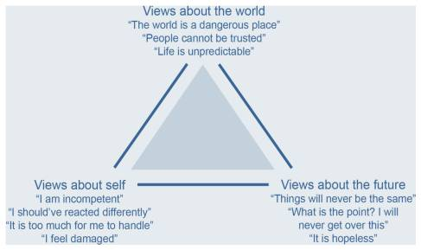
Cognitive Triad of Traumatic Stress
Notes:
How trauma impact they way we see ourselves, others and the future. This impacts our behaviors and how we approach interpersonal and intimate relationships
Vulnerability is Scary/ Vulnerability is Deserved
Avoid Emotional pain/ Emotional Pain is Normal
Become Guarded and Controlling/ Become Exposed Powerless

Slide 13
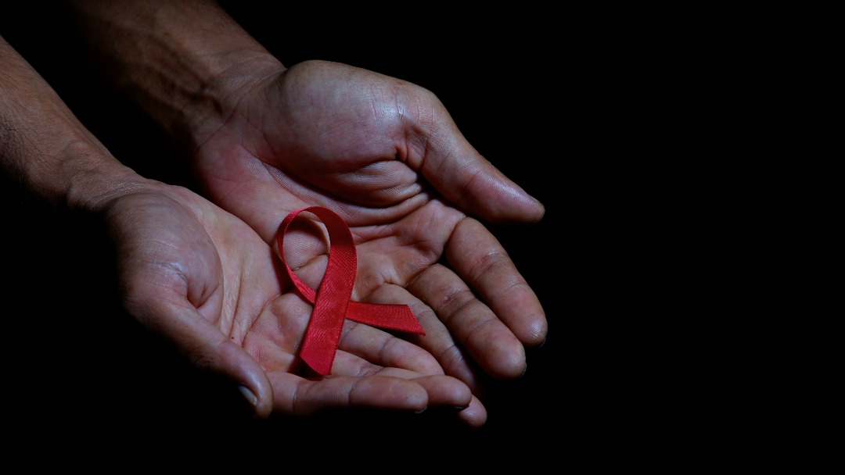
Disclosing Your Status

Slide 14

In the same storm, but not in the same boat
Dating and HIV+
Image: Barbara Kelley Wall Street Journal, 4/23/2020
Notes:
In the storm but different boat
The boat represents individual circumstances i.e. access to resources, finances, family/friend support, age, health etc
Self-disclosure: reveal something about ourselves that is not readily apparent
Decisions to self-disclose vary with circumstances
Outcomes of self-disclosure varies as well
There is no perfect roadmap for how to disclose
Nor is there a one size fits all answer

Slide 15
Disclosure
Disclosure of HIV status is a difficult decision.
Disclosure is personal and private. It is a choice, however there are:
Risks and benefits
Impact on others
Impact on self
Notes:
What is d.isclosure? The dictionary defines it as “to reveal, to admit.” That is, we are revealing something about ourselves that is not otherwise evident and that perhaps we don’t reveal to everyone.
Deciding who to disclose to, what to disclose, why to disclose, when, and where is an on-going process—one that is stressful, can create fear and anxiety, and can change relationships.
The decision to disclose is personal and how to disclose is complicated. There are risks and benefits to weigh and there are fears to conquer.
Disclosure of HIV status is difficult, and the difficulty sometimes arises from what we think the other person’s reaction might be. There is still so much stigma and fear associated with HIV that disclosure can be risky. We may know someone who has been rejected by family or loved ones, fired from their job, or shunned by their friends after disclosing their HIV status. We may also know someone who benefitted from disclosure; they gained strength, confidence, and found support and love for who they are with their secret revealed.

Slide 16
Disclosure
Women who are dating have to face the question of disclosure with each new relationship.
Some women prefer to get the issue out into the open immediately.
Others prefer to wait and see if the relationship is going to develop beyond casual dating.
Either way you should have "the talk" well before you find yourself in a sexual situation,
Notes:
Dating is challenging because I want to tell this person about my HIV. But when’s the right time? Online, before we meet? During the first date? Before sex? Never? It’s complicated because as much as I know that my HIV will have zero impact on their health, they still believe it will.”

Slide 17
GENERAL GUIDELINES
Here are some things to think about when you’re considering telling someone you’re dating that you have HIV:
Know why you want to tell them. What do you want from them?
Anticipate their reaction. What’s the best you can hope for? What’s the worst you might have to deal with?
Prepare by informing yourself about HIV. You may want to give articles, links, or a hotline phone number to the person you tell.
Get support. Talk it over with someone you trust and come up with a plan.
Accept that you can’t control how others will deal with your news.

Slide 18
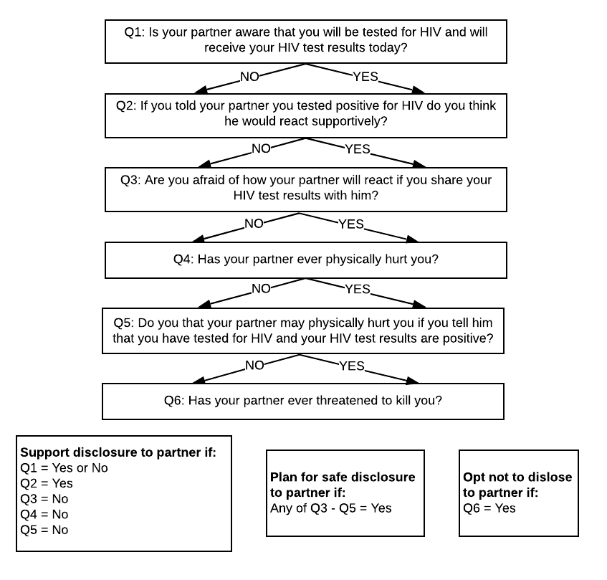
HIV disclosure: Is there potential for Domestic violence?

Slide 19
Approaching Disclosure
Start with self-acceptance.
Build a support system.
Educate yourself
Examine your possible reactions.
Accept that your date is "allowed" to reject you (in the same way you are "allowed" to reject your date)
Prepare your secondary disclosures.
➢Don't think of the disclosure as a "bombshell" or something you should apologize for
➢Don’t lead with an exit line.
➢If your love interest decides to move forward, discuss ways to do so.
➢If your love interest decides not to move forward, turn to your support network.
Notes:
Remember that dating is a process of finding the right person for you. Whether or not you are living with HIV, dating almost always includes some rejection, and it is important to be prepared for that. Almost everyone has some trial runs before finding that special person!

Slide 20
Partner Services
Anonymous Third Party: Specially trained local health department staff notifies partners without disclosing any information about the original client.
Dual Disclosure: The original client wants to disclose to partners him- or herself with the support of trained HIV Partner Services staff. Trained staff can provide immediate linkage to services once the original client has told the partner of their exposure.
Self Disclosure: The original client notifies his or her partner(s), after working with trained HIV Partner Services staff to develop a disclosure plan.
Notes:
HIV Partner Services is a free service offered through local health departments. The program helps HIV positive people in notifying their sexual and/or needle sharing partners of possible exposure to HIV. HIV Partner Services are always voluntary, client-centered, and confidential for both the person living with HIV and their partner(s).
The HIV Partner Services Program provides three options for letting partners know they may have been exposed to HIV and/or STDs and provide linkages to testing and medical care.

Slide 21

The Partner Services Unit can assist HIV positive individuals with informing their sex partners or train providers to perform counseling and referral services for patients. Call (213) 744-3338 for more information.

Slide 22
Sexual Negotiation: The Conversation
Negotiation is the establishment of certain limits and safewords.
It is also a way to discuss what each partner wants in the sexual relationship.
It’s helpful to put HIV status in the context of a broader discussion about intimacy and safer sex.
These conversations should include both people discussing their:
STI and HIV testing history,
current risk factors,
Interest in different types of sexual encounters, and
Safer sex.
Notes:
Negotiation differs from consent in that consent asks a partner for a yes or no approval

Slide 23
Sexual Negotiation: Three Strategies
Informational
Sweet Talk (Gentle Persuasion)
Hardline
Notes:
Informational-Explain what you desire and why it is important (i.e. condom/barrier use)
Sweet Talk-Console and use gentle persuasion to underscore points
Hardline- If there is no conversation/negotiation there is no sex

Slide 24
4 Steps to Dating After Trauma
Take Stock of the Lasting Impact of Trauma
Create and Maintain Healthy Boundaries
Safely Test the Water
Practice Self Care

Slide 25


