Slide 1

TRAINING
Policy Priorities and Legislative Docket Development Process
Updated 12.20.21

Slide 2
Learning Objectives
Learn about the functions of the Public Policy Committee and how the COH’s policy priorities and legislative positions are developed.
Learn about the Board of Supervisors guidance for Commissions on taking positions on legislative bills.

Slide 3
What is policy?

Slide 4

“Public policy” and “policy”: laws, regulations, and executive orders at different levels of government in the United States.
Source: https://climaterealityproject.org/blog/government-101-what-public-policy. Accessed 10/20/20
Notes:
To solve or address relevant and real-world problems

Slide 5





Examples of Public Health Policies
Notes:
Public Health policy is defined as the laws, regulations, actions, and decisions implemented within society in order to promote wellness and ensure that specific goals are met.

Slide 6

Examples of Commission on HIV (COH) Policy Accomplishments
HIV Names Based Reporting
CD4 Reporting
Ryan White Reauthorizations
Affordable Care Act/1115 Waiver
Local funding for STD response
Medical Care Coordination expansion
Continued advocacy for syringe exchange programs, housing, health equity, and civil rights
Facilitated community meetings and panels on HIV/STD control in the adult film industry
This Photo by Unknown Author is licensed under CC BY-ND

Slide 7
Public Policy Committee
Responsibilities

Slide 8
Public Policy Committee
Resources: Since some PP Committee activities may be construed as outside the purview of the Ryan White Part A or CDC planning bodies, resources other than federal funds cover staff costs or other expenses used to carry out PP Committee activities.
Notes:
Study, advise, and recommend to the BOS policies and other actions/decisions on matters related to HIV

Slide 9
Public Policy Committee Responsibilities
A. Advocating public policy issues at every level of government that impact Commission efforts to implement a continuum of HIV services or a service delivery system for Los Angeles County, consistent with the comprehensive HIV plan;
B. Initiating policy initiatives that advance HIV care, treatment and prevention services and related interests;
C. Providing education and access to public policy arenas for the Commission members, consumers, providers, and the public;

Slide 10
Public Policy Committee Responsibilities
D. Facilitating communication between government and legislative officials and the Commission;
E. Recommending policy positions on governmental, administrative, and legislative action to the Commission, the BOS, other County departments, and other stakeholder constituencies, as appropriate;

Slide 11
Public Policy Committee Responsibilities
F. Advocating specific public policy matters to the BOS, County departments, interests and bodies, and other stakeholder constituencies, as appropriate;
G. Researching and implementing public policy activities in accordance with the County’s adopted legislative agendas;
H. Advancing specific Commission initiatives related to its work into the public policy arena; and
I. Carrying out other duties and responsibilities as assigned by the Commission or the BOS.

Slide 12
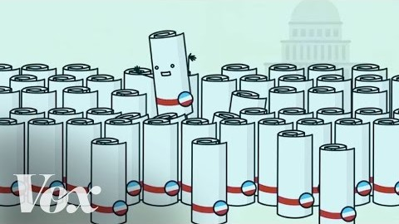
How a bill really becomes a law: What Schoolhouse Rock missed

Slide 13
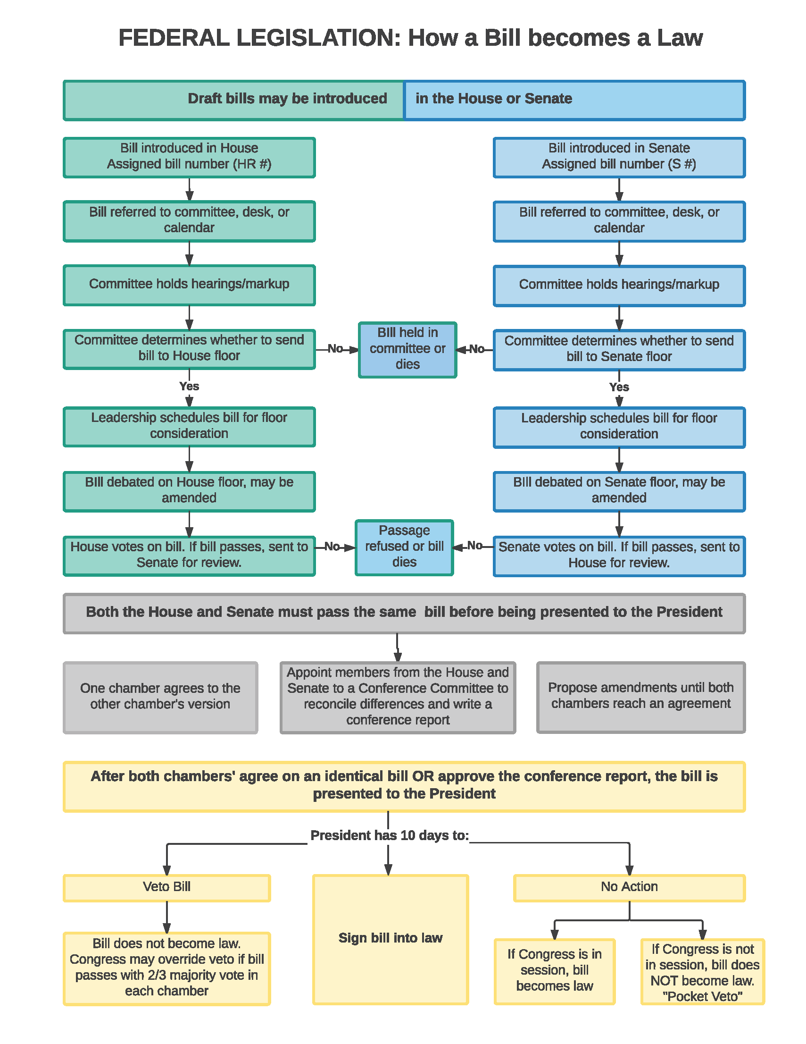

Slide 14
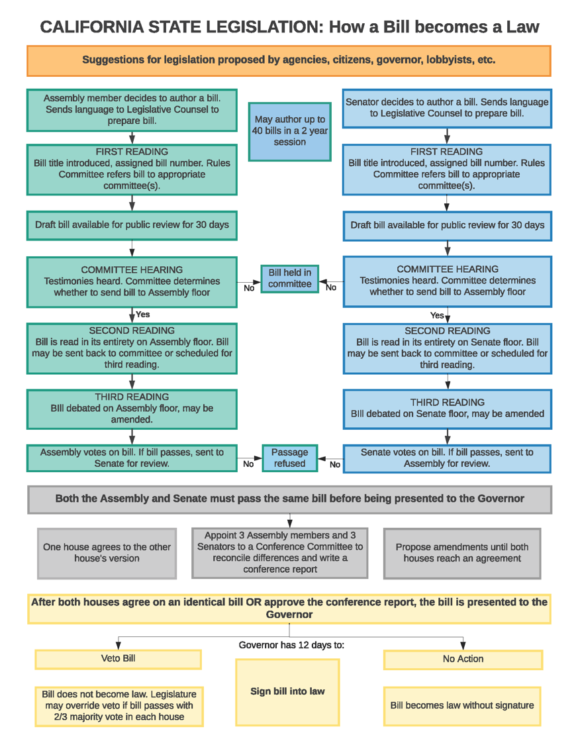

Slide 15
Board of Supervisors Guidance for Commissions on Taking Positions on Legislative Bills

Slide 16


Only the Board of Supervisors (BOS) set policy for the County.
County commissions and other advisory bodies may make recommendations and subject to review and approval by the CEO’s Legislative Affairs Office.

Slide 17
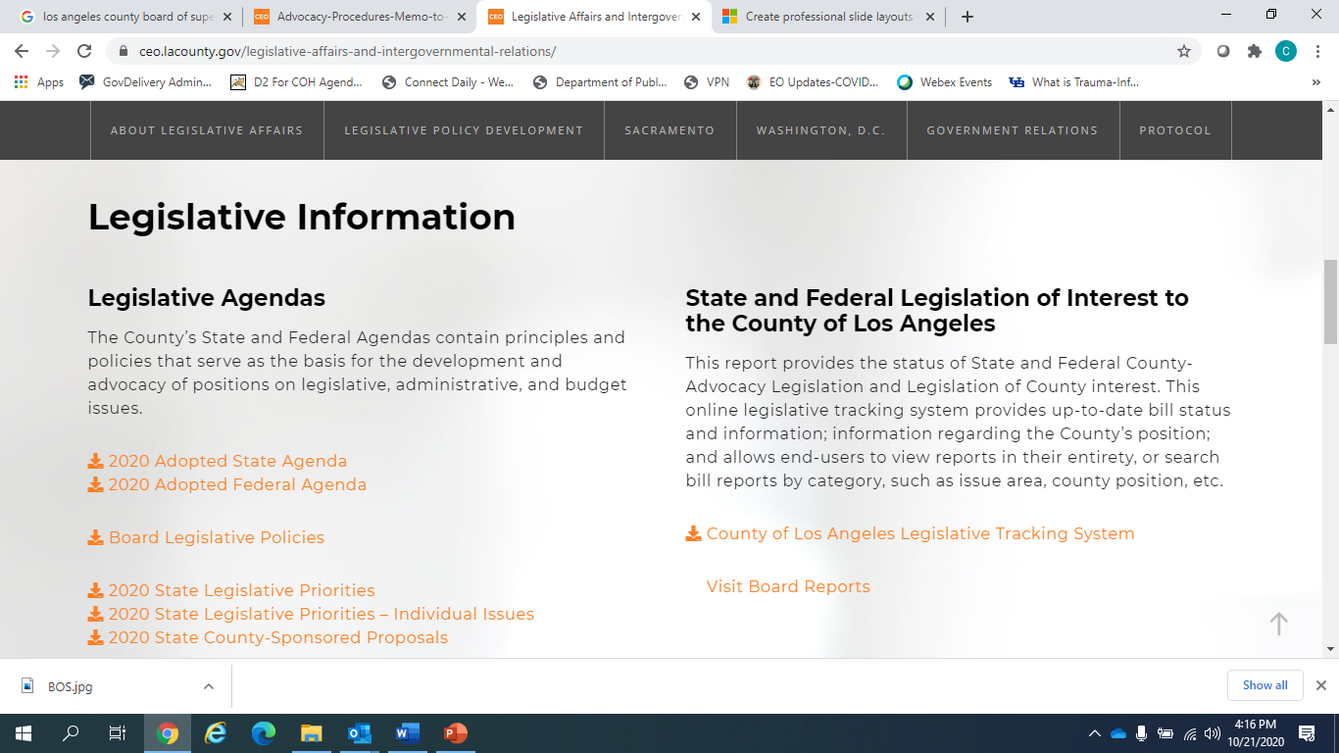
BOS Legislative Agendas
https://ceo.lacounty.gov/legislative-affairs-and-intergovernmental-relations/
Notes:
Note to Katja and Lee: To show audience where BOS leg agendas are posted

Slide 18
How the COH’s Policy Priorities are Developed

Slide 19
Policy Priorities
Guide and focus the Committee’s selection of policy issues to discuss and champion
Ensures that community needs are the focus of policy deliberations
Aligned with service priorities set the Commission through the priority setting and resource allocations process
Broadly worded to allow for swift actions and response to rapidly changing political environment

Slide 20
How the Legislative Docket is Developed

Slide 21
Timeline
Follows calendars for both legislative houses of the State of CA
Planning with grassroots coalitions usually occurs in multi-year settings to ensure continuity of policy and advocacy efforts
Track BOS deliberations and legislative agenda decisions
Bills are tracked @ https://leginfo.legislature.ca.gov/
Committee begins to track bills introduced and lists potential bills for consideration by Committee (Jan-Feb)

Slide 22
Timeline
CA budget tracked thru May revise
Collaborate with State Department partners to ensure that implementation of signed bills remain true to their intent
Federal and State bills for Committee deliberations may come from Committee members, community, and other stakeholders
Caucuses and Committees also provide input and highlight policy issues for PPC to discuss

Slide 23

Committee members review bills and other policy issues
Assess pros and cons
Invite speakers to help inform discussion
Request more information from authors
Use policy priorities to guide deliberations
Legislative Docket and Policy Priorities sent to COH for approval

Slide 24
Looking Ahead: Commitment to Racial Justice
Supporting the Black/African American Caucus
Upholding the Commission’s Solidarity Statement
Ensuring that all efforts to End the HIV Epidemic are rooted in dismantling racism, stigma and achieving optimal health for ALL

Slide 25


Slide 26







https://hivconnect.org/
510 S. Vermont Ave, 14th Floor, Los Angeles, CA 90020
hivcomm@lachiv.org
213.738.2816
HIVCommissionLA
@HIVCommissionLA

