Slide 1

LA County Citizens’ Economy and Efficiency Commission
January 7, 2016
RoOm 525, Hall of Administration

Slide 2
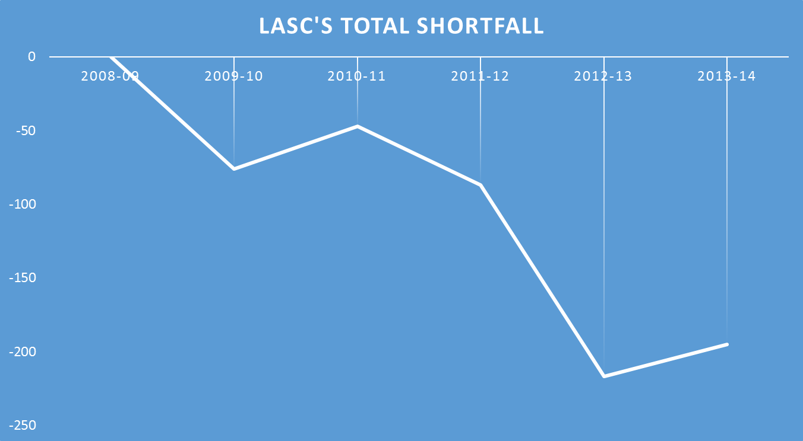
Budget Changes/Reductions Over The Past 5+ Years
The Era of Downsizing

Slide 3
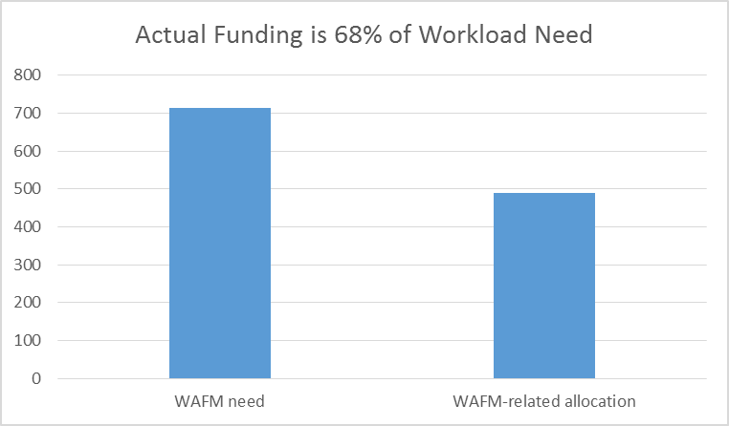
(Millions of dollars)

Slide 4
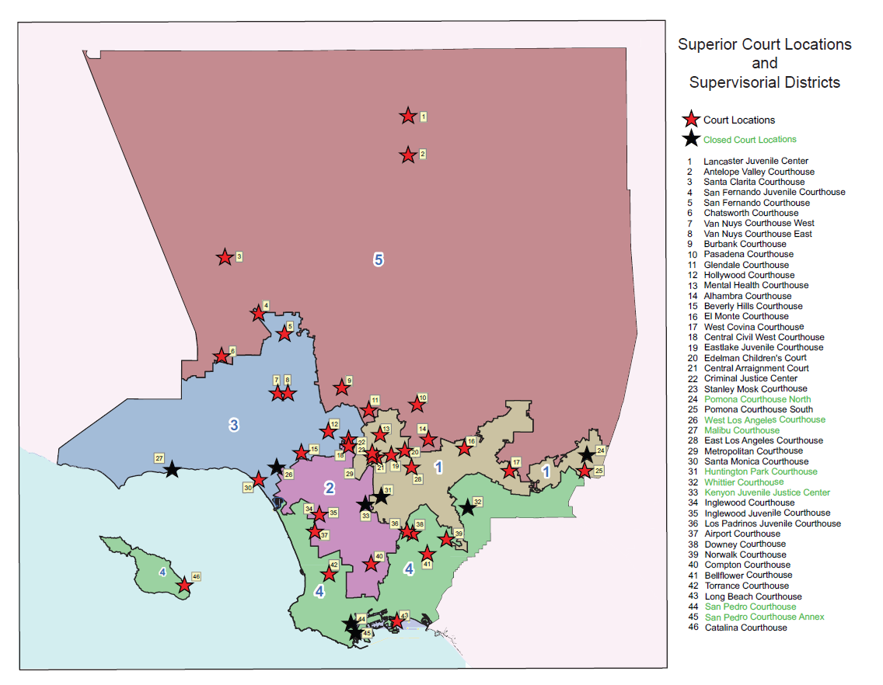

Slide 5
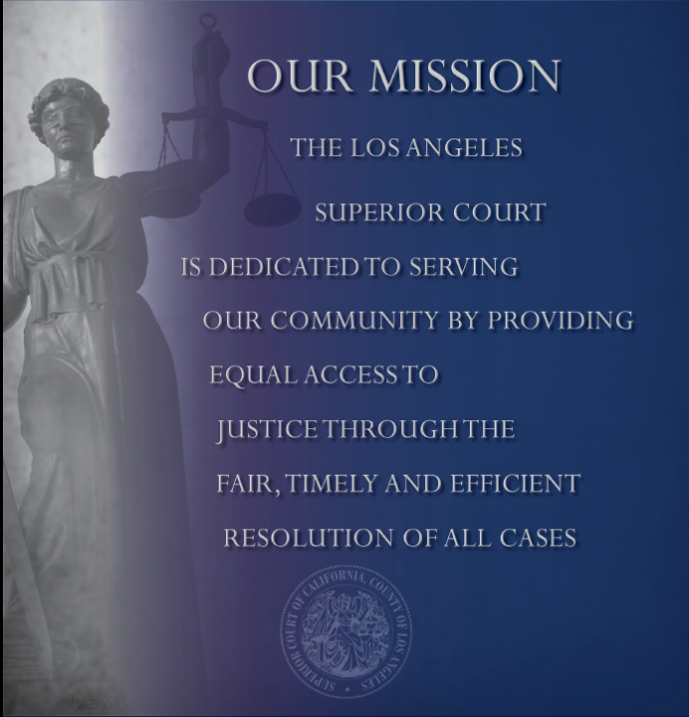

Slide 6
Schedule of Upcoming Changes
Jan 2016 CRS all direct calendar (IC) courtrooms
March 2016 e-Delivery PI
March 2016 Dashboard for all JOs
April 2016 CMS small claims
May 2016 CMS probate
Sep 2016 CMS limited civil
Oct 2016 CMS traffic
Oct 2016 CMS juvenile
Nov 2016 CMS unlimited civil
Mar ‘17, Sep ‘17 CMS family law
Aug 2017 CMS criminal

Slide 7
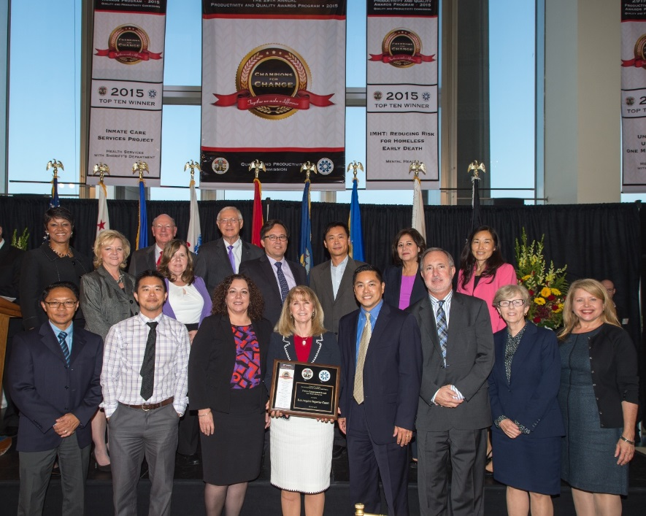
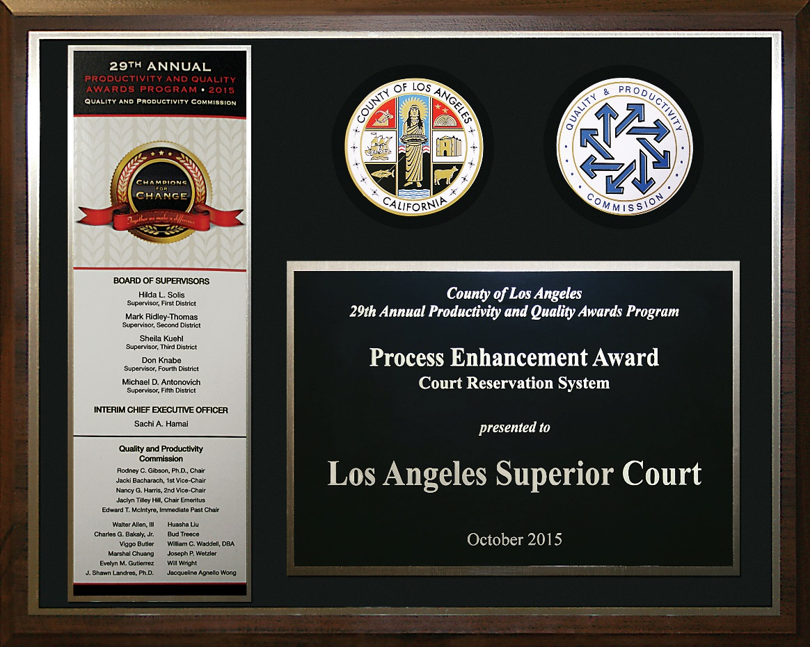
Civil Reservation System 73courtrooms 90,605 reservations for motions have been scheduled

Slide 8
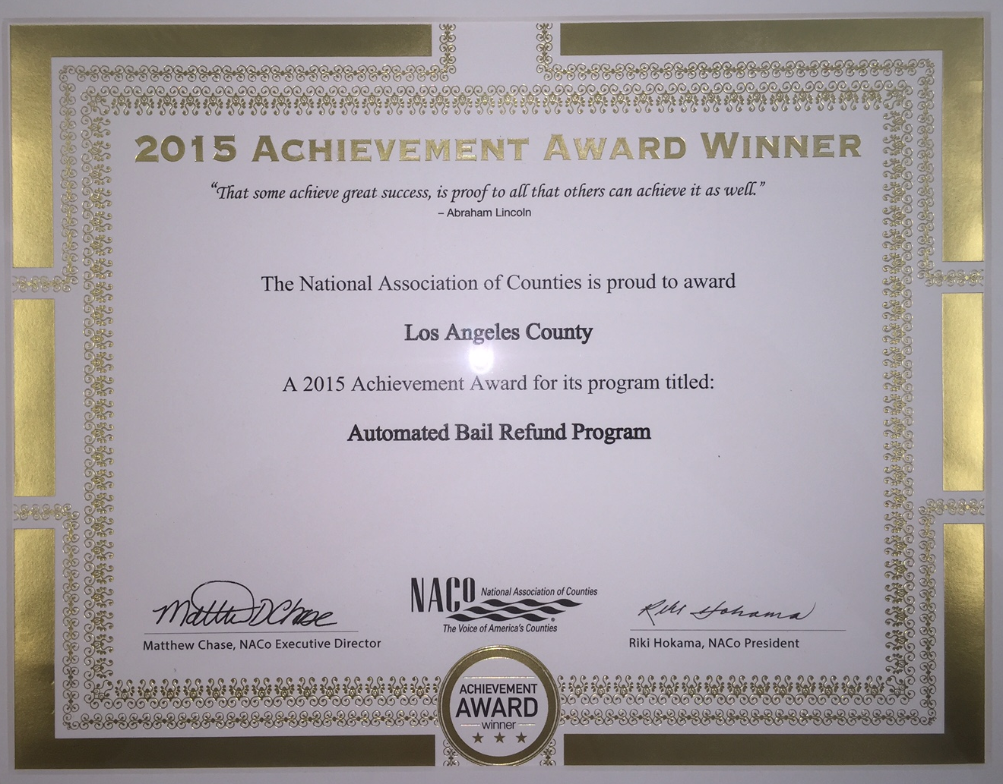
Automated Bail Refund Program 2015 National Association of Counties Achievement Award Winner

Slide 9
Amnesty Stats up to December 2015
284,905 inquiry calls were handled by GCS staff.
30,963 forms were completed by people to start the amnesty application process, involving about 82,800 citations. Almost 99% of all forms completed were completed online.
Of the 33,138 payment transactions made, 73% were made as part of the partial payment plan
$3.2 million total traffic fines and fees were collected
Of those who qualified to have their fines and fees reduced under amnesty, 92% received the maximum reduction of 80%.

Slide 10
Continuous Improvement Culture
Engagement
Awareness
Design
Tailoring
Assessing

Slide 11
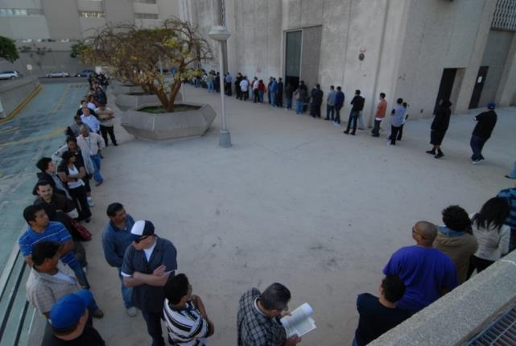
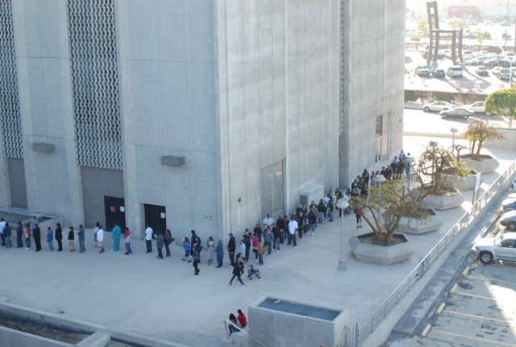
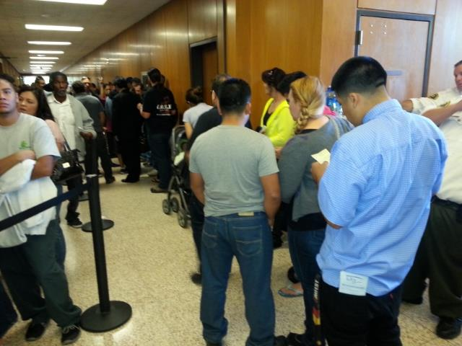
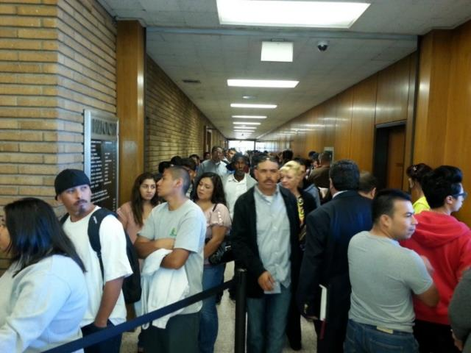

Slide 12
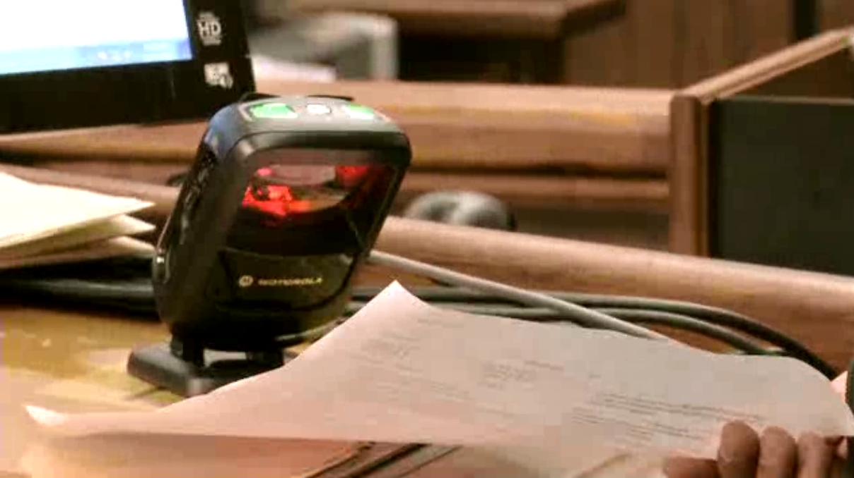
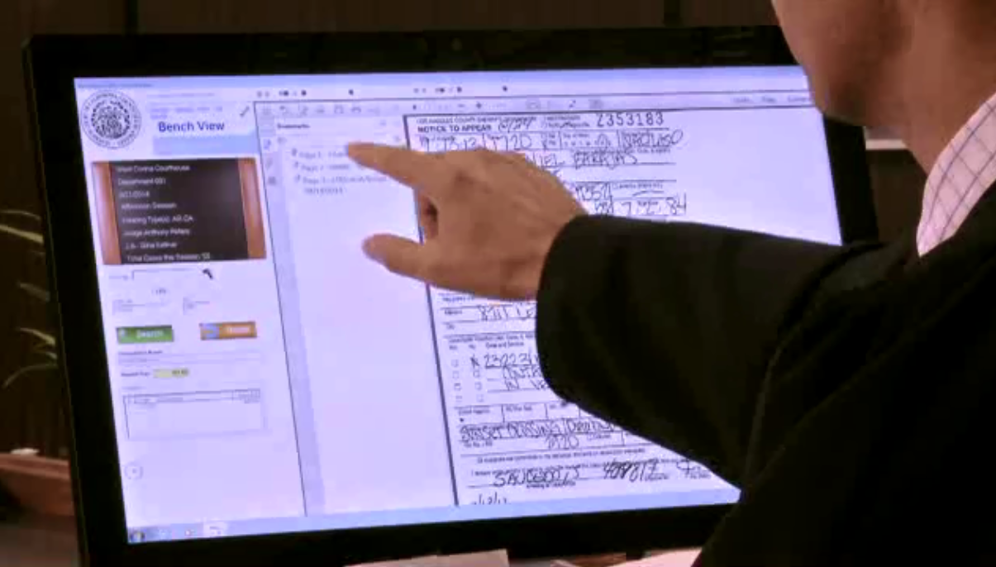
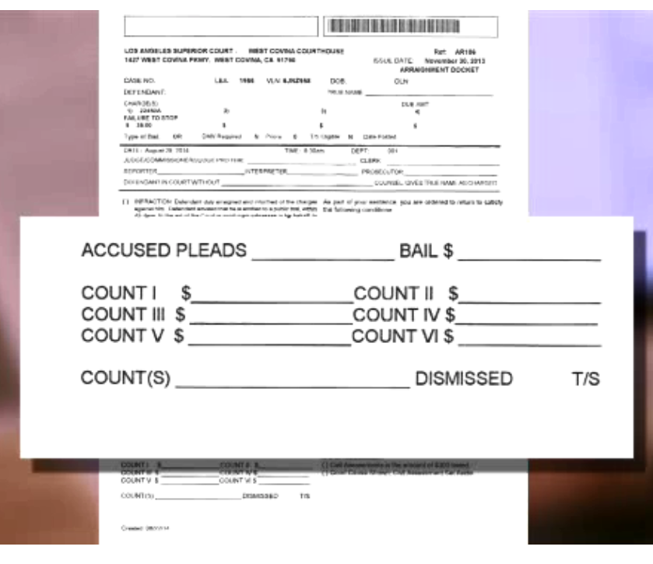
Bench View

Slide 13
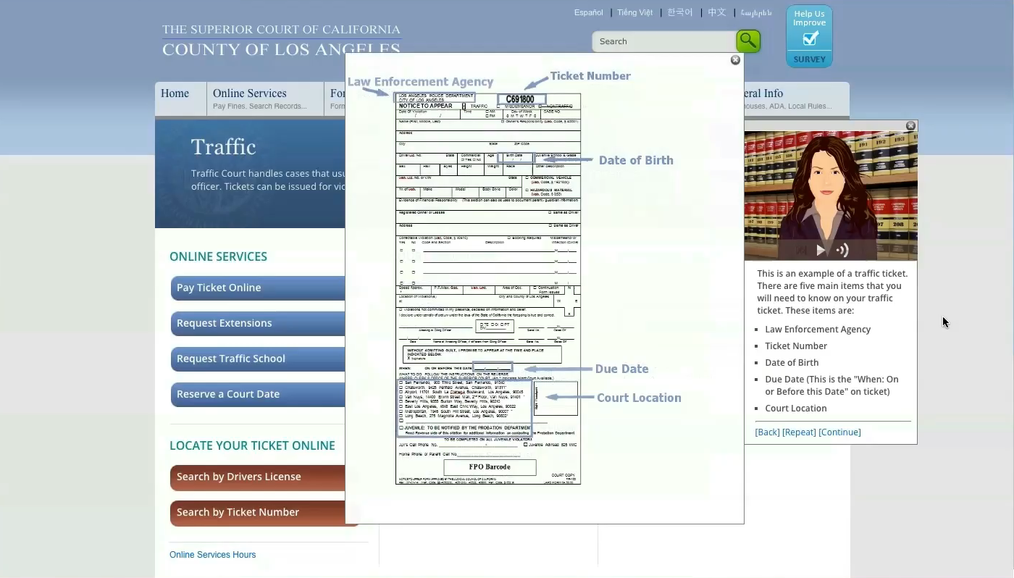

Slide 14
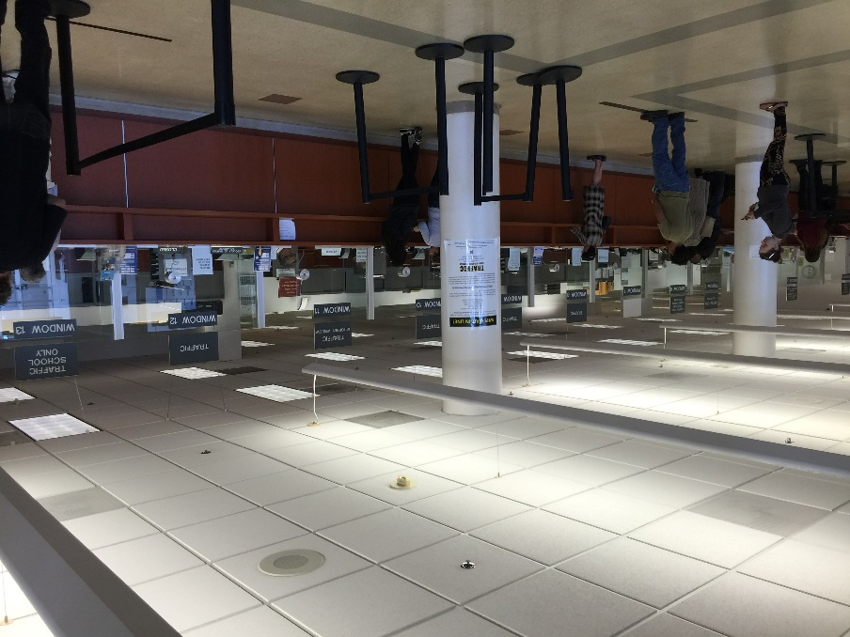
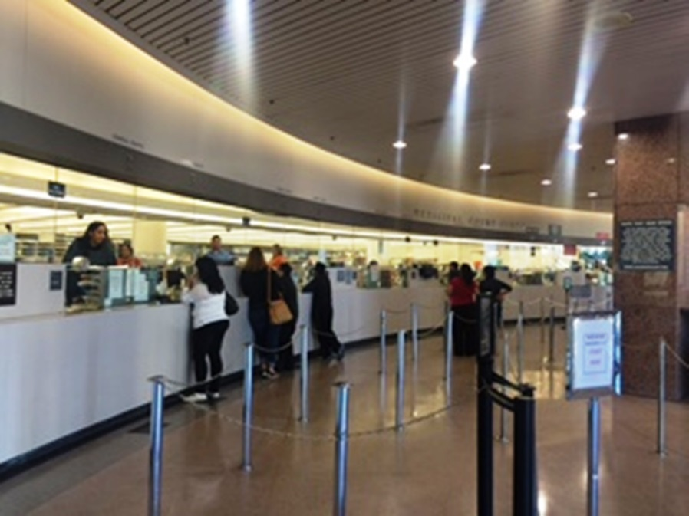
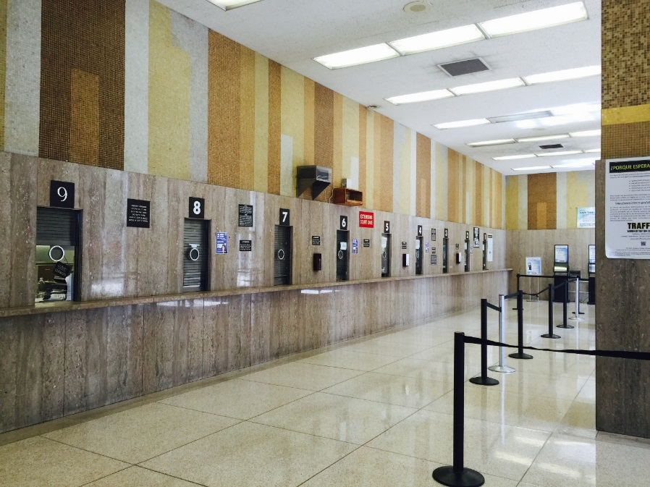

Slide 15
ice
DDES (aka Justice Partner Portal)
Month-Year | # Agencies | # Queries / mo
October 2013 | 2 | 436
October 2014 | 17 | 2091
October 2015 | 36 | 11,477
Agency | Queries
City of Los Angeles-Los Angeles Police Department | 4,362
Los Angeles County-County Counsel's Office | 2,046
City of Alhambra-Alhambra Police Department | 738
Office of the State Public Defender- | 541
City of Pasadena-Pasadena Police Department | 439
Los Angeles County-Department of Human Resources | 426
City of Burbank-City Attorney's Office | 393
City of Inglewood-Inglewood Police Department | 387
City of Beverly Hills-Beverly Hills Police Department | 333
California Appellate Project-California Appellate Project | 331

Slide 16
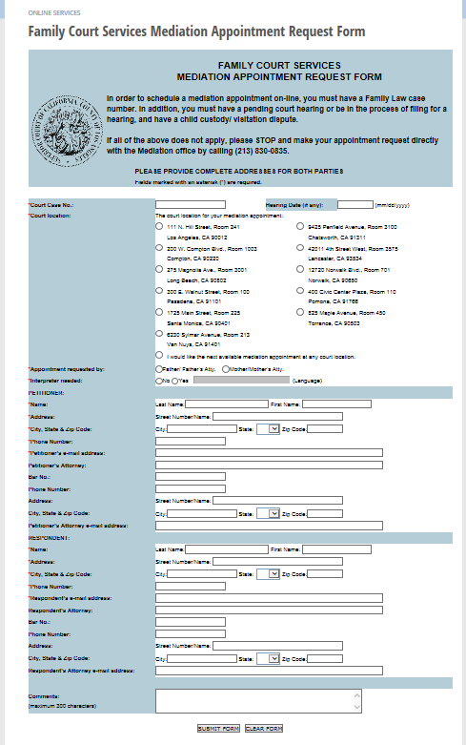
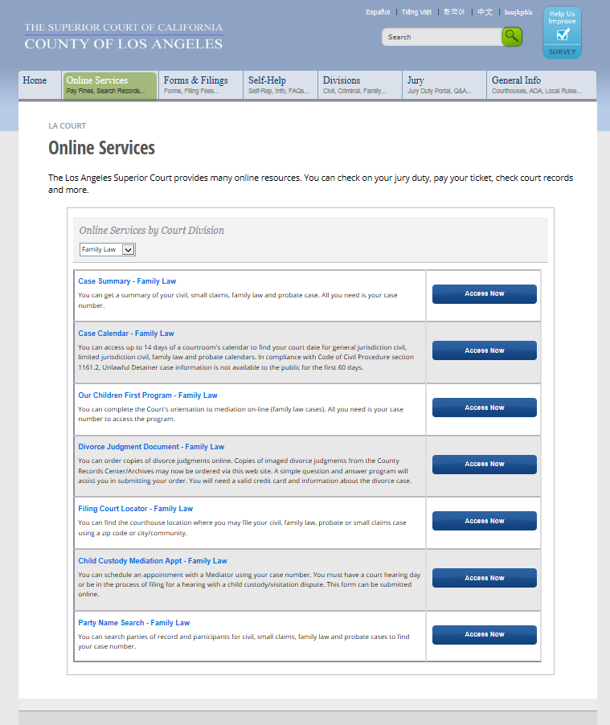
Family Law Mediation Online Programs

Slide 17
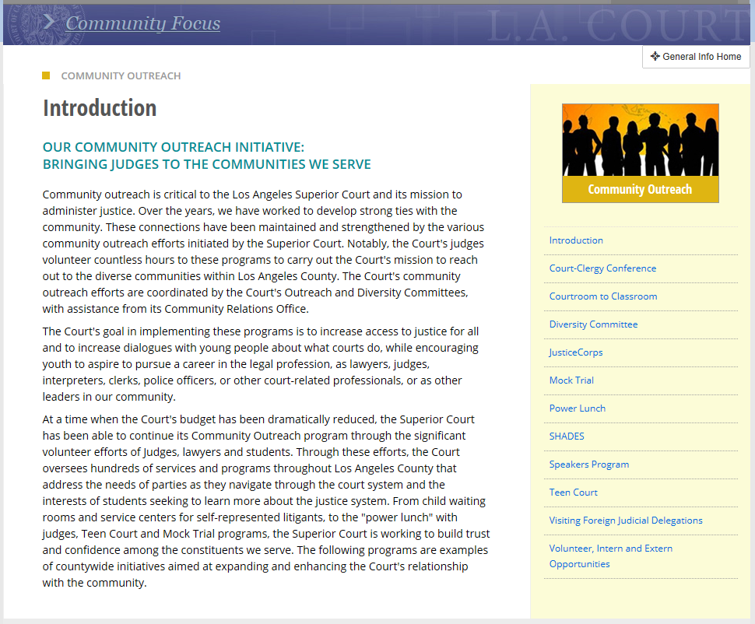

Slide 18
Language Services Provided by the Court
Interpreters available in all courthouses
Case types:
Criminal
Traffic
Juvenile delinquency
Mental health
Domestic violence
Elder and dependent abuse cases
Juvenile dependency including termination of parental rights
Probate conservatorships and guardianships
UD cases
Civil harassment
Family law
Small claims

Slide 19
QUESTIONS?

