Slide 1
Bus Shelter Solutions
ELA College/LACC/ Rio Hondo College

Slide 2
East LA College (3 submissions)

Slide 3
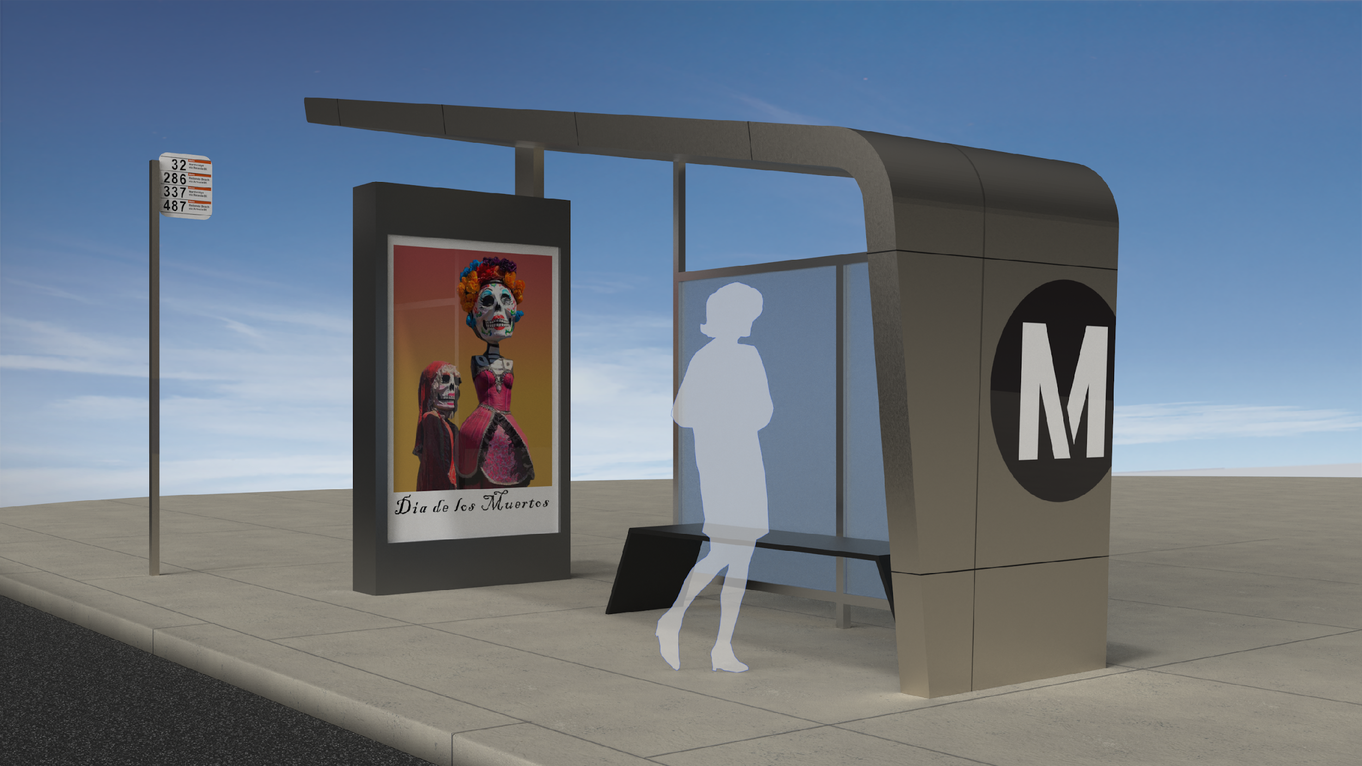
The Slant Bus Shelter
Kimberly Mejia, ELA College 1
1
2
4
3
5
1 Photovoltaic panels on roof
2 LED concealed lighting in ceiling
3 LED kiosk sign
4 Glass panels
5 Painted metal bench

Slide 4
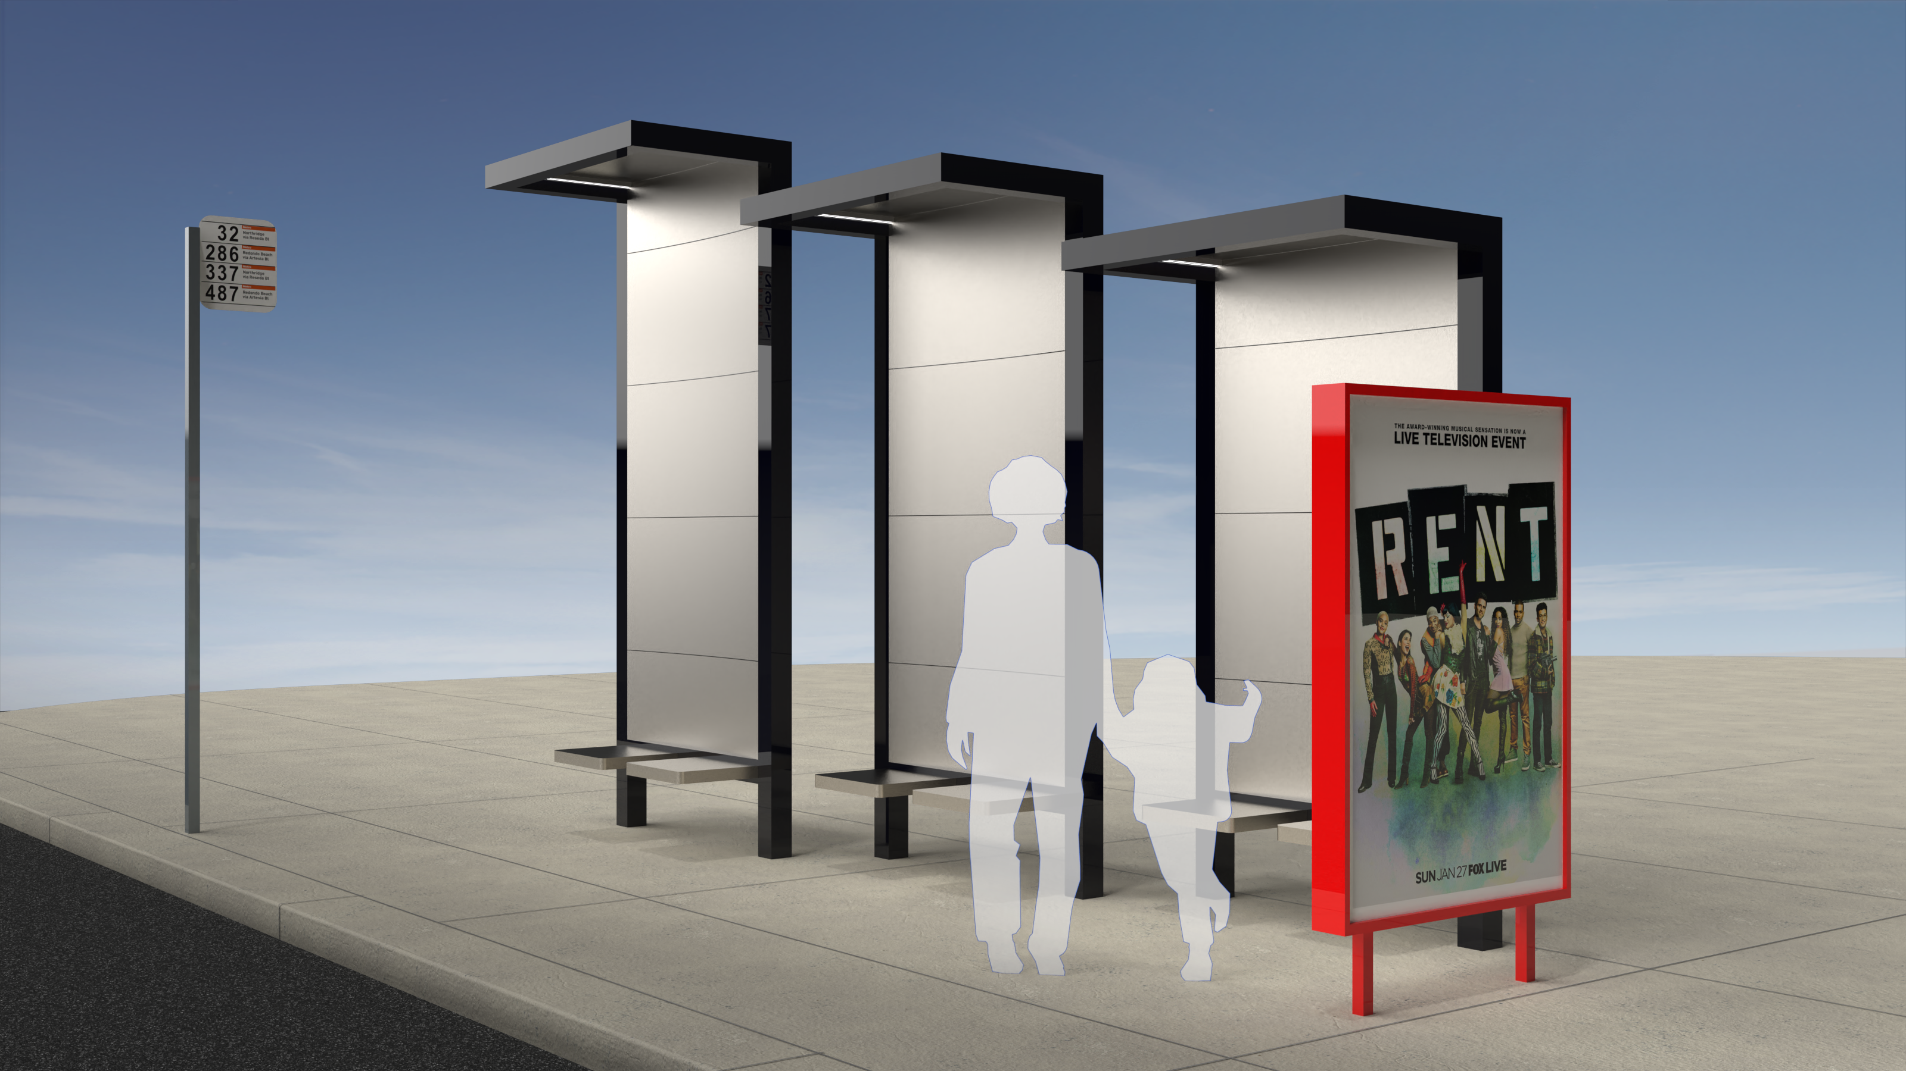
Three Steps Bus Shelter
Jimmy Maceda/Jose Garcia, ELA College 2
1st Place

Slide 5
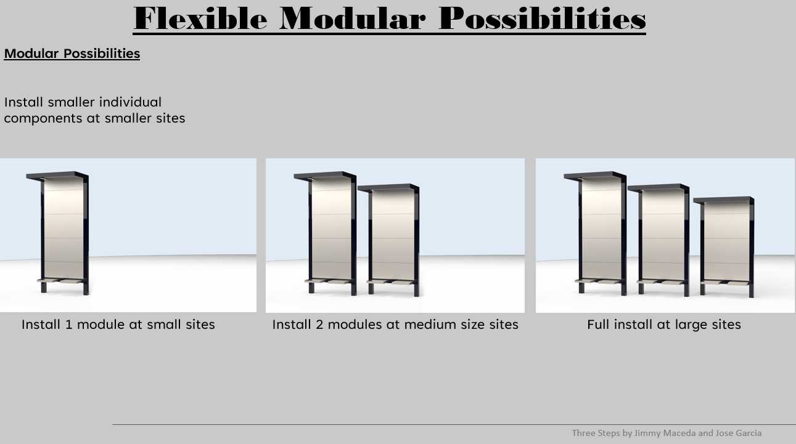

Slide 6
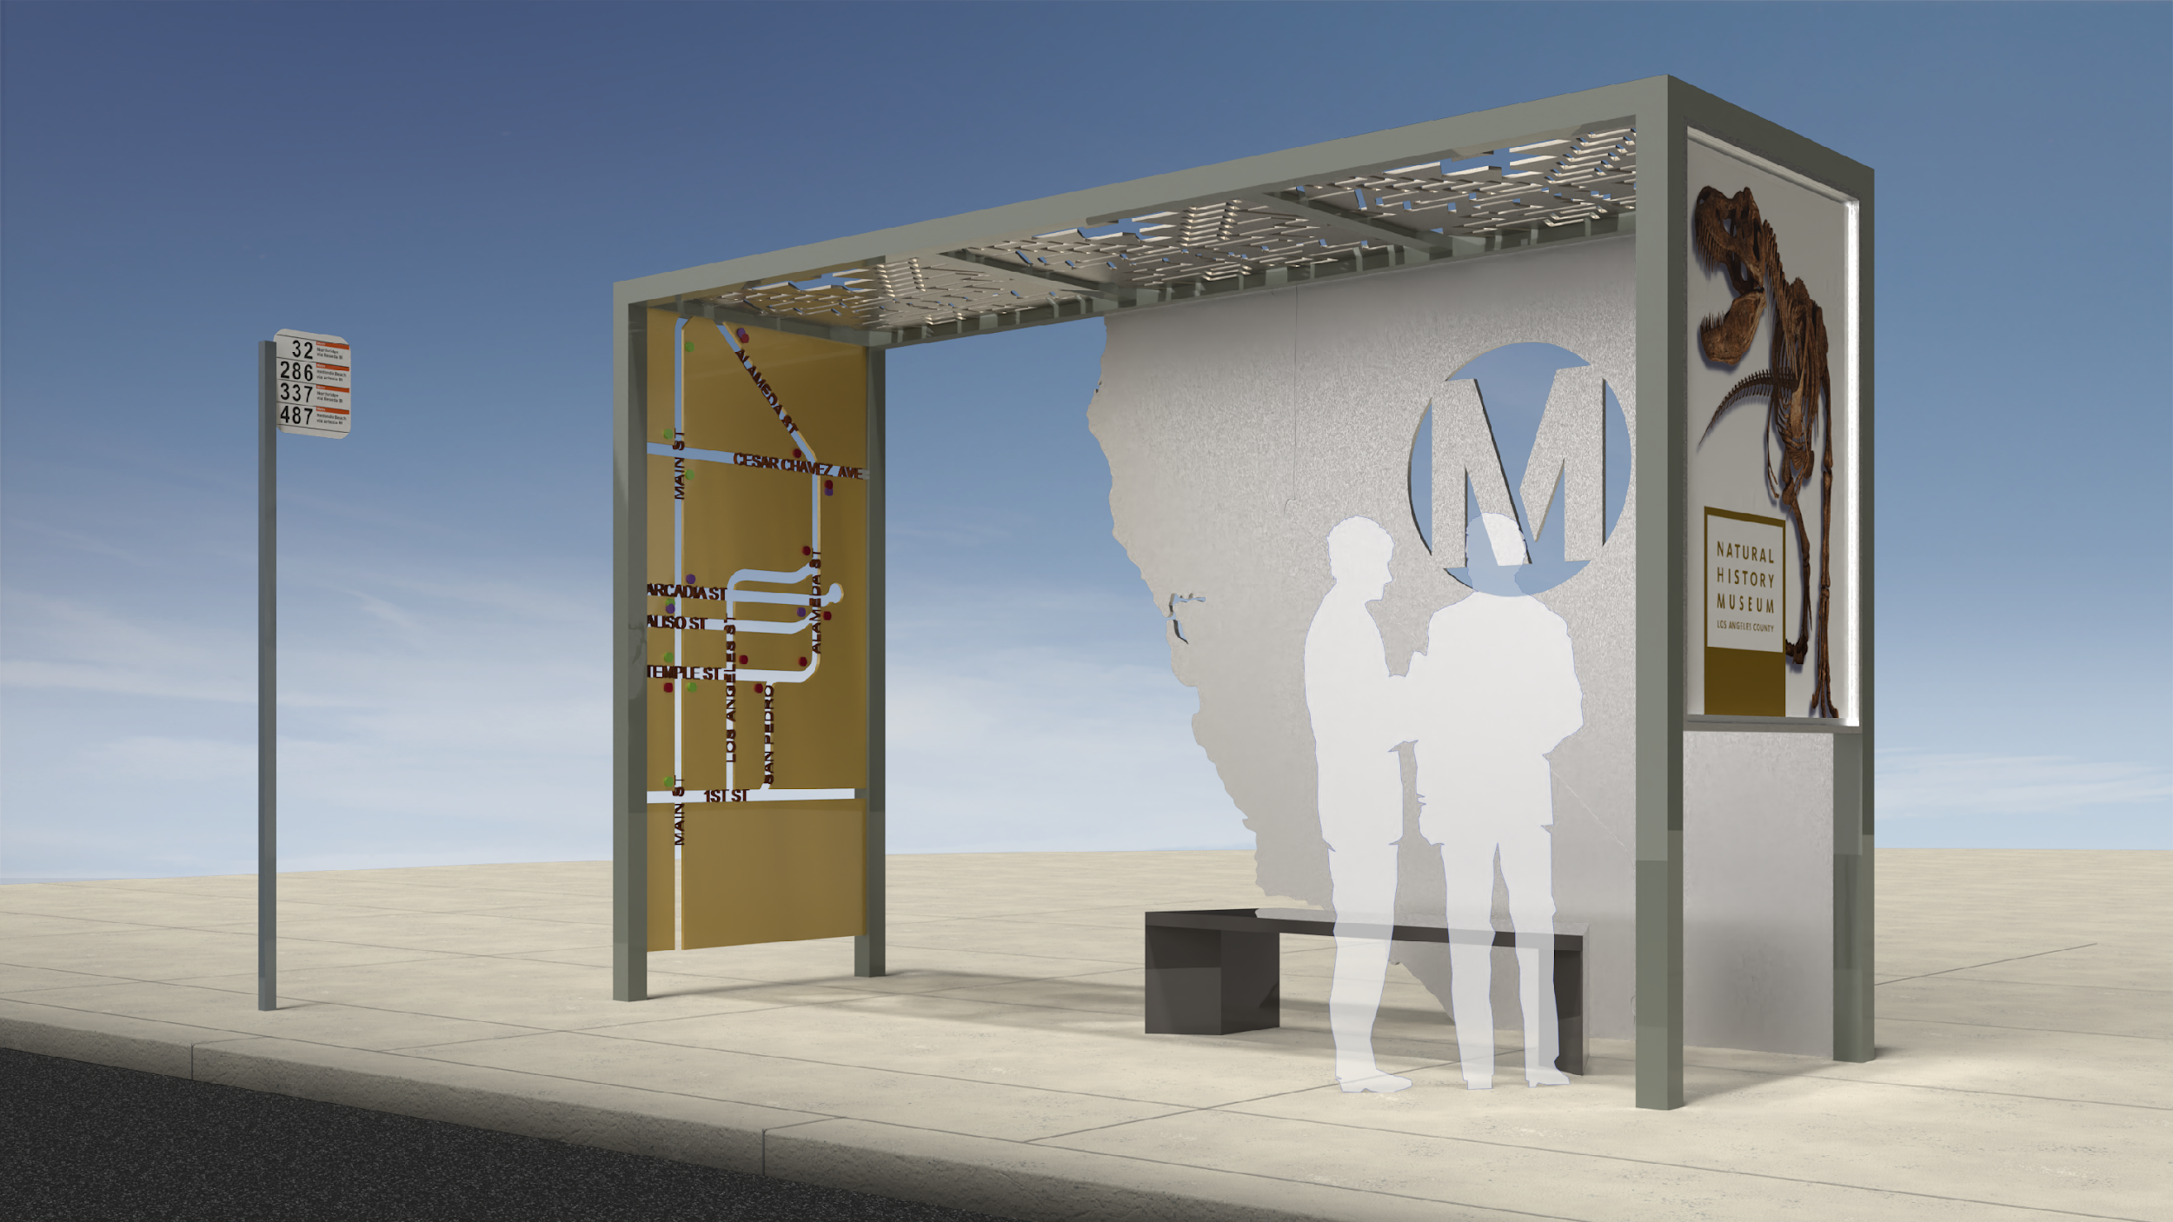
Right On Time Bus Shelter
Hugo Torres/V Trujillo, ELA College 3
2nd Place

Slide 7
Los Angeles City College (1 Submission)

Slide 8
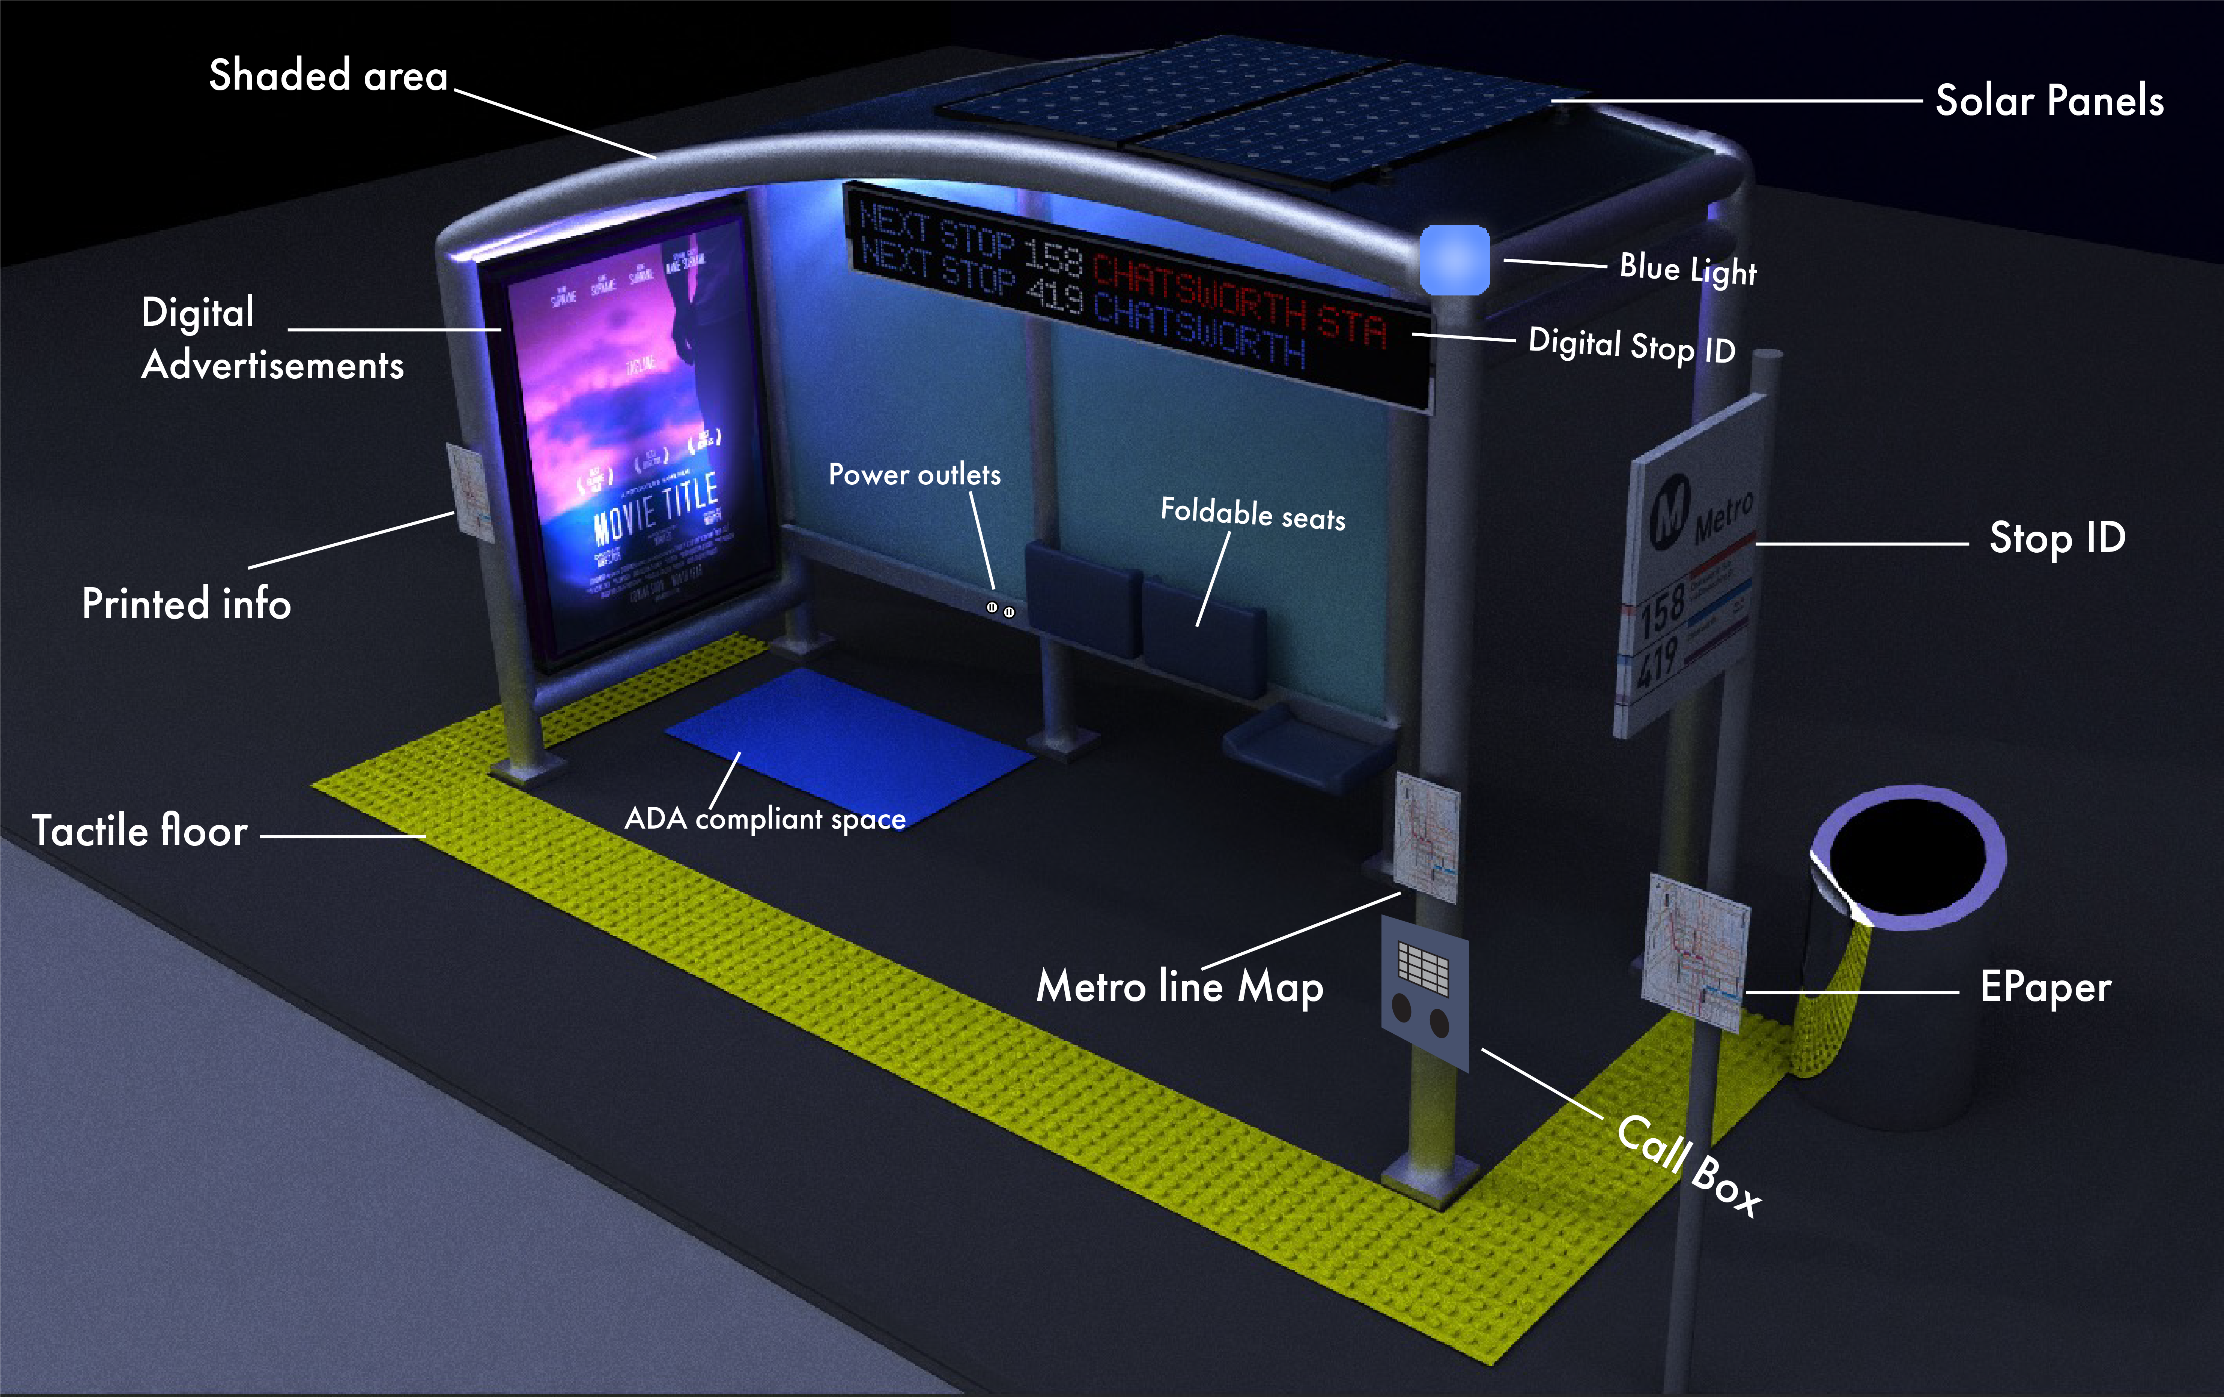
Honorable Mention
Los Angeles City College

Slide 9
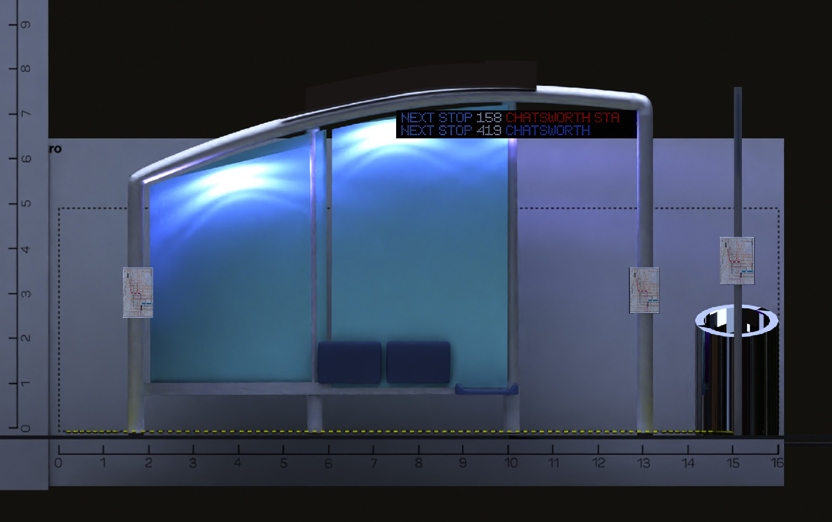
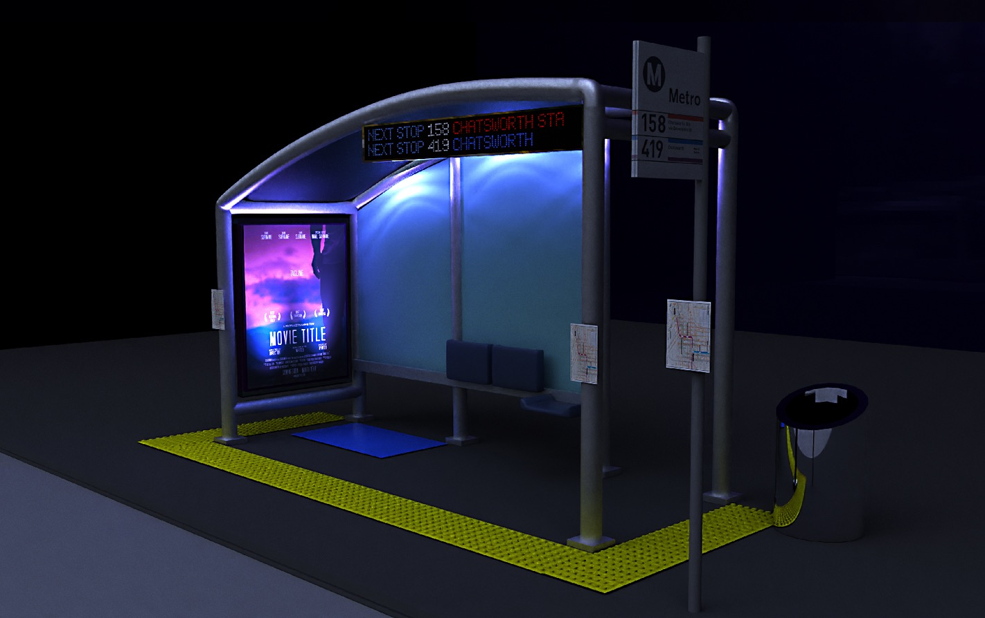
Front View

Slide 10
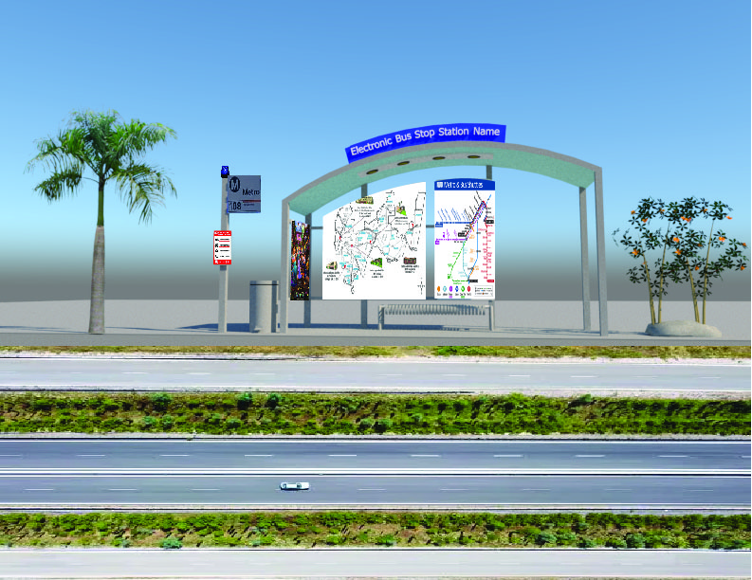

Slide 11
Rio Hondo College (2 Submissions)

Slide 12
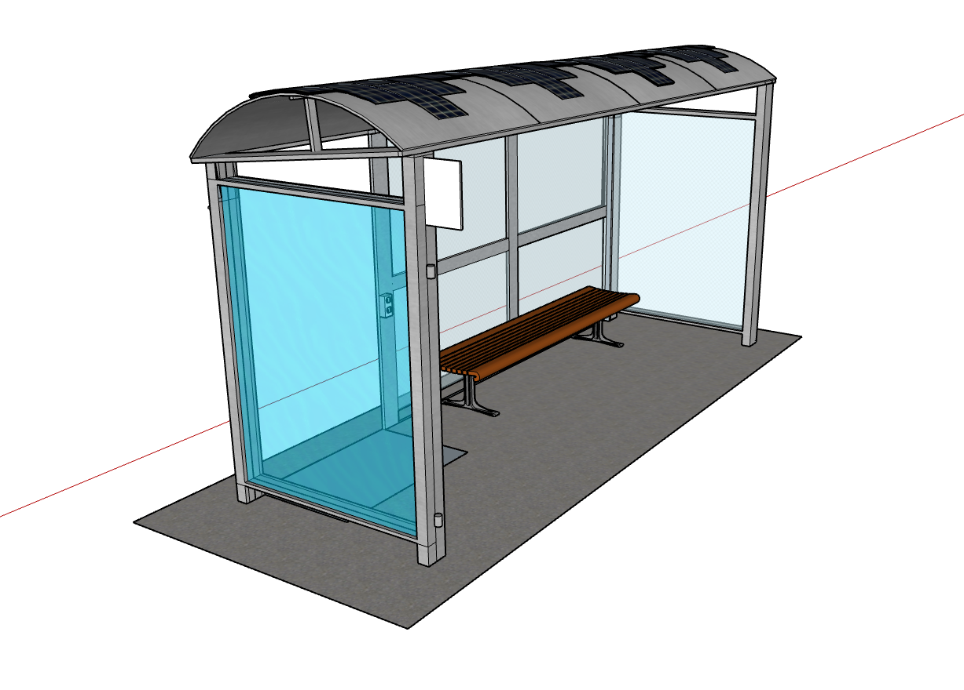
Rio Hondo College Group 1
Fatima Barajas/Lycette Moran/Joseph Ryan George/Jasmina Elsayed
FINAL DESIGN

Slide 13
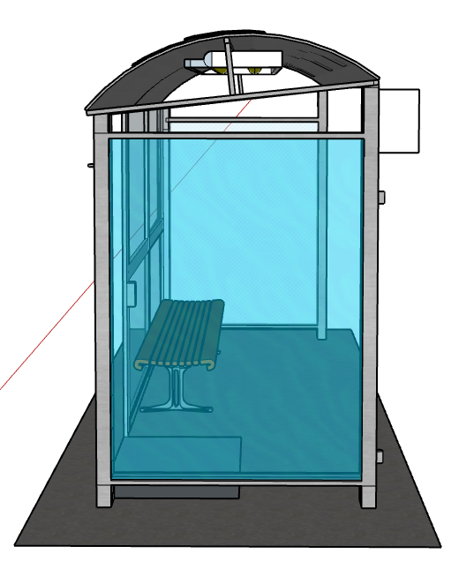
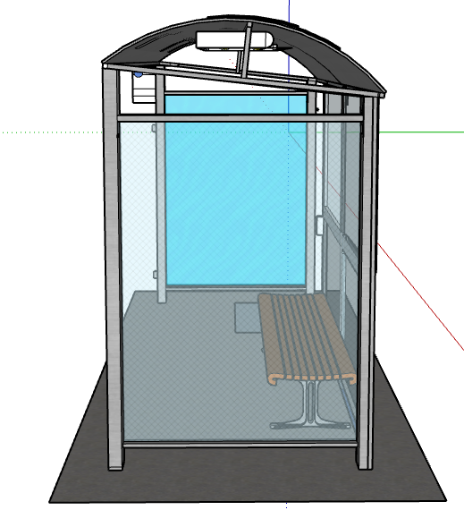
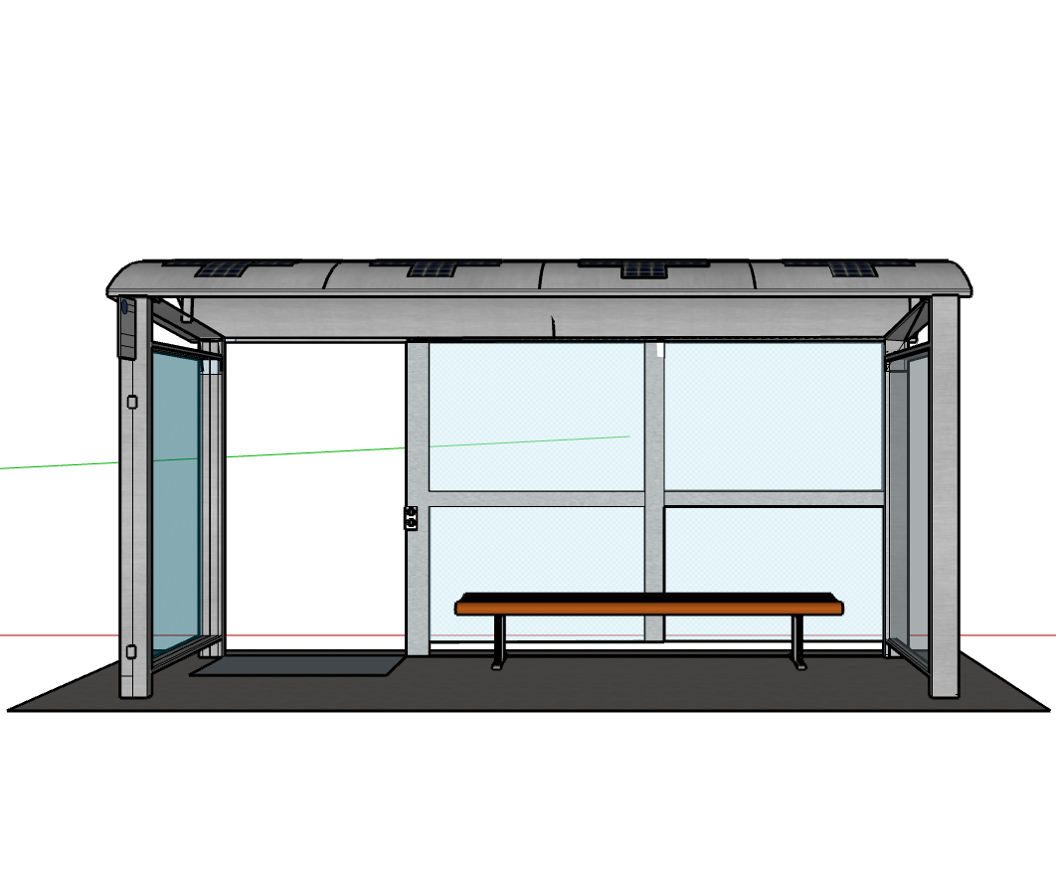
Rio Hondo College Group 1
Fatima Barajas/Lycette Moran/Joseph Ryan George/Jasmina Elsayed
FINAL DESIGN

Slide 14
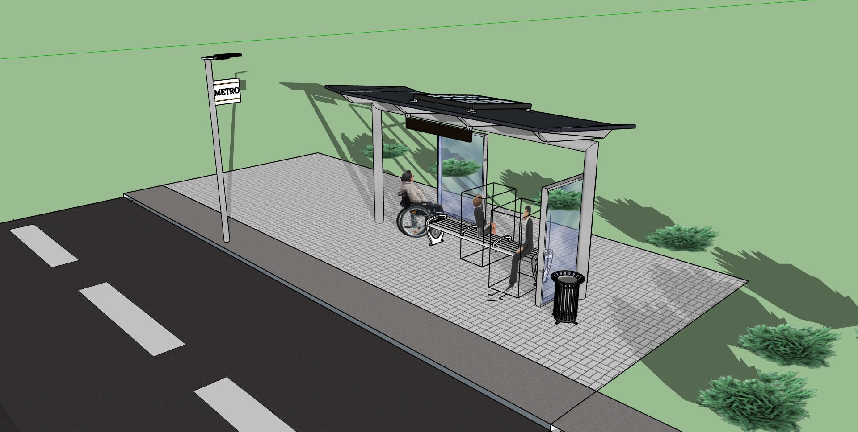
Final Design
RH Line Station
Rio Hondo College Group 2
Marco Rodriguez/Remberto Candelario/Jacob Perez
3rd Place

Slide 15
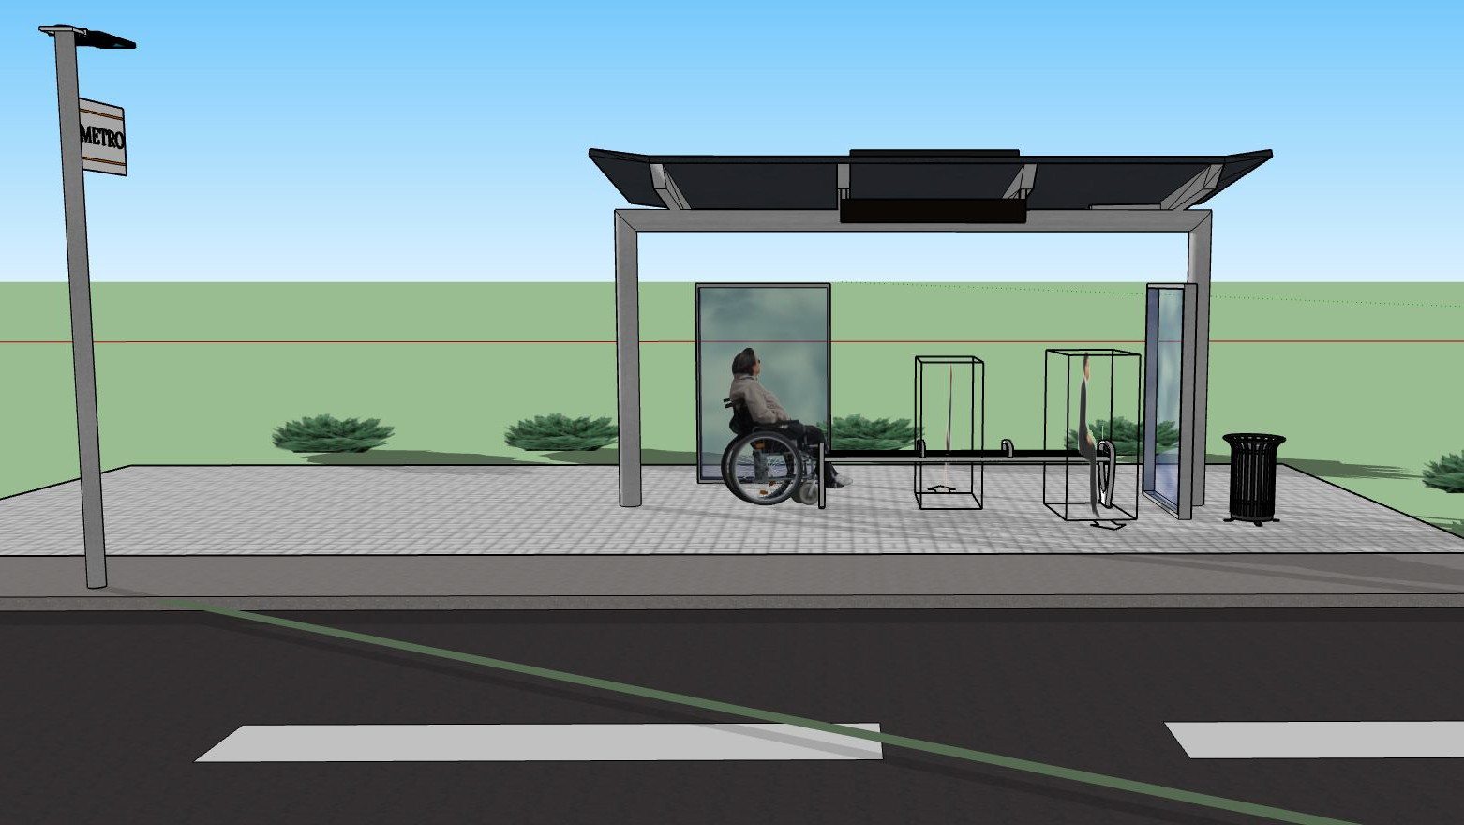
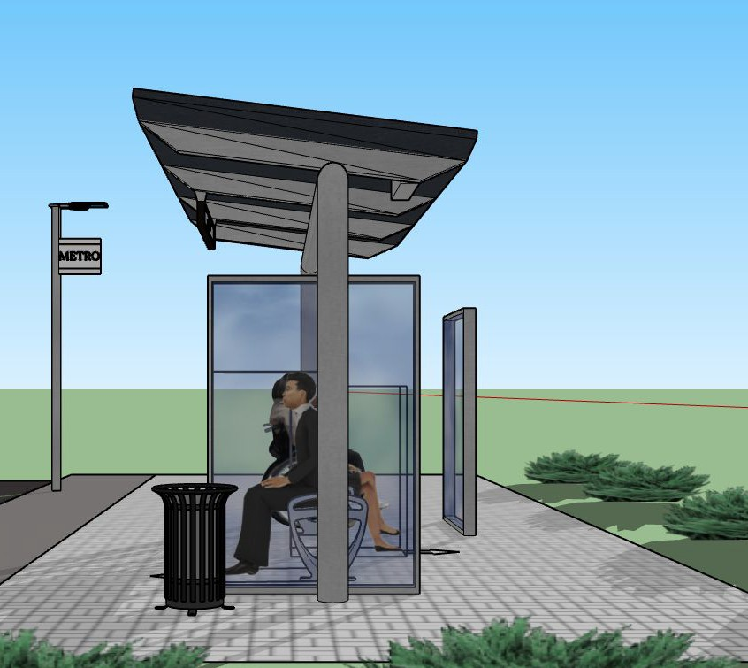
Side View
RH Line Station
Rio Hondo College Group 2
Marco Rodriguez/Remberto Candelario/Jacob Perez
Front View

Slide 16
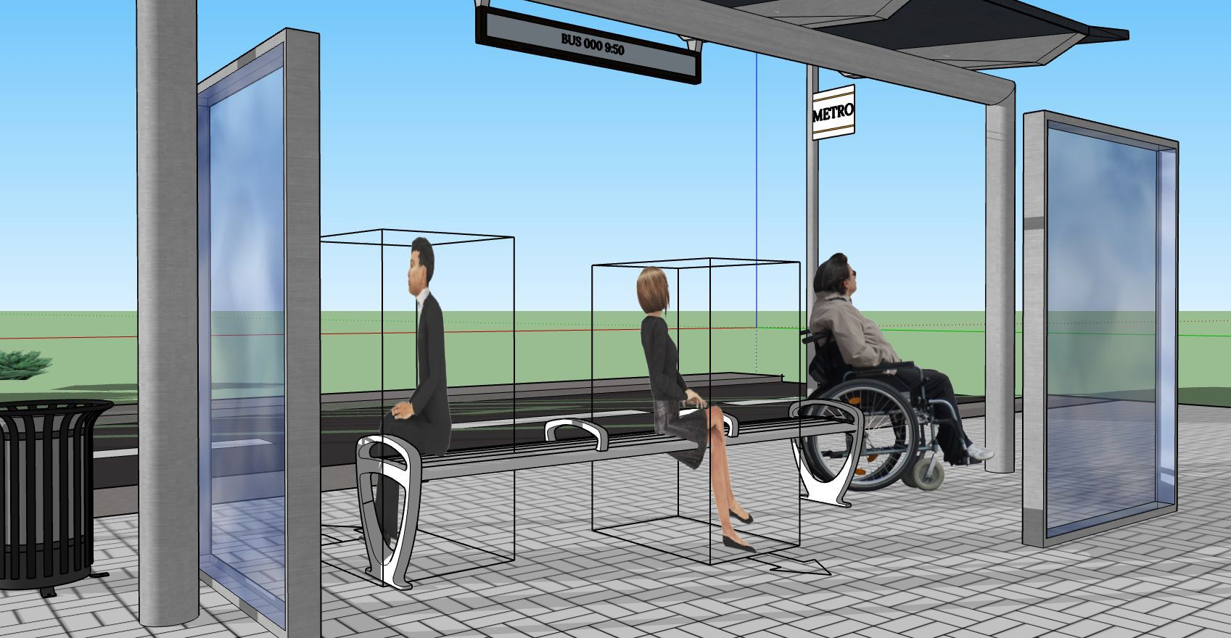
Perspective View
RH Line Station
Rio Hondo College Group 2
Marco Rodriguez/Remberto Candelario/Jacob Perez

